Slide 1
CTE Graduation Pathways, HSBPs, and the Foundation of Hope for “At Promise” Youth
WA Summer Transition Institute, August, 2023
Kimberly Hetrick, Ed.D., OESD 114
Notes:
“At Promise” - more historically underserved and under-represented populations and areas - communities of color, persons with disabilities, disconnected youth, individuals in recovery, LGBTQ, individuals with past criminal records, including justice impacted and re-entry participants, trainees participating in SNAP, TANF, WIC, veterans and military spouses, women, first-generation/immigrants, Tribal, workers living in rural and remote areas
These are the students who often are left out of the equity equation - they have been in the shadows.
‘At-Promise’? Can a New Term for ‘At-Risk”
https://www.edweek.org/policy-politics/at-promise-can-a-new-term-for-at-risk-change-a-students-trajectory/2020/01
At 17, Shira Parker has faced family substance abuse, homelessness, and disrupted schooling. But don’t call Parker an “at-risk” student.“When people refer to students being at-risk, I do feel like it puts negative expectations on these students,” said Parker, who lives in Perris, Calif., and is enrolled in a diploma program at SIATech, a high school dropout recovery program for students ages 16 to 24. “I believe calling students at-risk seems as if they are doomed already, and as if the expectation is to fail in life.”
California lawmakers agree. As of Jan. 1, 2020, all uses of the term at-risk in the state’s educational and penal codes have been changed to “at-promise,” a term that supporters argue is less stigmatizing.
“We know that language matters, and we know that using asset-based language is important,” said Elisha Smith Arrillaga, the executive director of Education Trust–West, a research and advocacy organization focused on California students.
“One of the reasons the name is so important is because of unconscious bias and all of the things we see play out when students are inappropriately labeled,” she said. “Changing the name is one important step, but there’s many other things to do as well.”

Slide 2
Topics
Hope Theory
CTE Fundamentals
Graduation Pathways
High School and Beyond Plans, IEPs and Transition Planning
HSBP Case Studies
Notes:
The purpose of this presentation today is to raise awareness of issues, topics and to help us all make better connections.
All links and notes are in the notes section of this presentation.
Please ask questions at any time.

Slide 3
HSBP: Building Hope
Notes:
Hope is the foundation of all that we do

Slide 4
Credit: Using the Science of HOPE to Support Outcomes, Becky Love and Terri Tchorzynski, National School Counseling Leadership Conference 2022
Notes:
Welcome to Hope Rising!
https://www.facebook.com/HopeRisingOklahoma/videos/431711318301768/?extid=CL-UNK-UNK-UNK-IOS_GK0T-GK1C

Slide 5
HIGH HOPE PEOPLE
Believe the future will be better
They have the power to make it so
There are many paths to their goals
None are free of obstacles
Notes:
Hope is a social gift - it happens in our relationships with others - it is about connection
Hope is not the goal - it is the framework/process for action to improve culture so that families etc. have the opportunity to thrive and enjoy wellbeing.

Slide 6
HOPE DEFINED
Hope is the belief that tomorrow will be better than today…
and you have the power to make it so!
Notes:
Today we are going to talk about the WHAT: The High School and Beyond Plan, IEP/Transitions and CTE and the WHY: Hope
Hope is the underlying element, the foundation, of post-secondary planning and successful CTE programming.
If a student feels he/she has the ability and you show them how the way (our job as educators/counselors) then they have hope…
Hope is different than wishing. You can use your imagination as a vehicle towards hope. Cast the vision, see yourself there, and access your willpower and waypower.
Hope is a framework for language where the outcome is focused on well-being
Hope is a velcro concept - when we nurture hope, hope rises and with it so too do other character strengths
Is Hope an emotion, a way of thinking, a feeling, a cognition?
Hope is a process so we can teach it. If it was a feeling, best we could do is help people manage it. So, we can can teach and nurture hope in our students, colleagues and families.
So if a child is not thriving in the classroom, perhaps the child does not see the classroom experience as a pathway to goal. Or said another way SCHOOL can be a good pathway to one’s goal.

Slide 7
Source: Using the Science of HOPE to Support Outcomes, Becky Love and Terri Tchorzynski, National School Counseling Leadership Conference 2022
Notes:
Chan Hellman's Hope Science work is the foundation for much of what we are sharing with you today.
Hope is not the goal - it is the framework/process for action/ to improve culture so that families etc. have the opportunity to thrive/ have wellbeing
Hope theory states that there are three elements of hope: Goal, agency and pathway
AND Hope can be taught
For the purposes of our presentation today, HSBP and CTE pathways are the goals to achieve.
As we go through the presentation today, you will note that Hope Theory and the High School and Beyond Plan share a common language such as “will power,” "agency" and "pathway"
Goals: Cognitive endpoint of purposeful behavior.
Can be either short- or long-term in nature.
Must be of sufficient value to motivate behavior
Pathways (Way Power) - refers to the ability to identify routes toward goals and to find new routes (problem solve) around obstacles if necessary
Mental roadmaps to goal attainment.
Ability to consider potential barriers with workable solutions.
Ability to identify multiple pathways.
Agency (Willpower) - is the ability to sustain motivation to move along these pathways
Mental energy to your pathway pursuits.
Ability to self-regulate thoughts, emotions and behaviors.
Focus your attention and intention on goal pursuits.

Slide 8
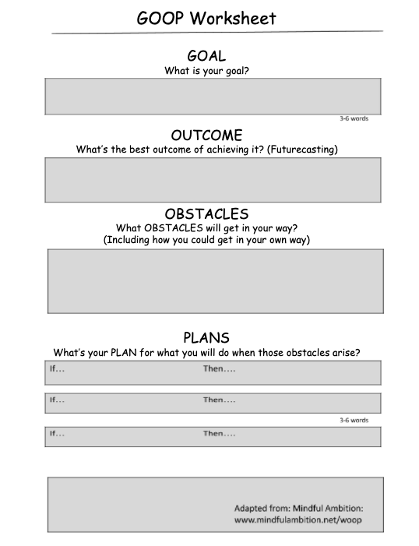
For Goal Setting or “Re-Goaling” when problem solving is needed
Adapted from https://mindfulambition.net/woop/
Notes:
GOOP Worksheet​
Adapted from https://mindfulambition.net/woop/​
​
​
GOOP = Goal, Outcome, Obstacles, Plans​
​
​
GOOP is such a simple but powerful strategy to work with youth AND adults in overcoming obstacles and achieving goals ~ you should check it out! :-)​
​
​
Other Goal Worksheets​
https://www.wichita.edu/about/conferences/documents/POWER/2020_POWER/Handouts/Phillips.Hellman.Handout2.HopeWorksheetOctober2019.pdf​
​
​
https://www.hope.ms.gov/sites/mccj/files/Hope%20training%20January%202021/S2Pathways%20To%20Goal%20Worksheet.pdf​
​
​
https://www.co.marion.or.us/CS/CFC/Documents/Hope%20Worksheet%202015.pdf

Slide 9
Hope is the belief that tomorrow will be better than today…
and you have the power to make it so!
“Hold fast to dreams,
For if dreams die
Life is a broken-winged bird,
That cannot fly.”
Langston Hughes
Notes:
If you are interested in more Hope Science training, Jeff Allen, OESD 114, and ask about Hope Navigators

Slide 10
CTE Fundamentals

Slide 11
Vision for Career Connected Learning in WA
Every young adult in Washington will have multiple pathways towards economic self-sufficiency and fulfillment, strengthened by a comprehensive statewide system for career connected learning.

Slide 12
What we know….
Youth with disabilities are persistently under-represented in paid employment (Lindsay et al., 2015).
According to the U.S. Bureau of Labor Statistics, in 2022 youth with disabilities between the ages of 16-24 were employed about half as often as their peers without disabilities (U.S. Bureau of Labor Statistics, 2023)
Students with disabilities are more likely to achieve their aspirations for life after high school if they are provided the right combination of opportunities, instruction, services, and supports (Trainor et al., 2020) [AND HOPE]
Notes:
https://www.bls.gov/news.release/pdf/disabl.pdf
We know our students are “college and career” capable and it is our job to help them identify their strengths and align their strengths and passions with meaningful courses of study.

Slide 14
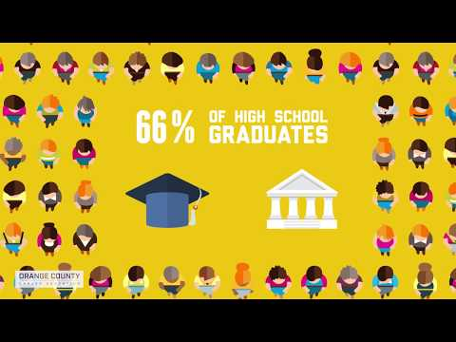
Success in the New Economy
Notes:
10 Minute video https://www.youtube.com/watch?v=bauDp4NdPK8
Nov 12, 2018 • This update to the viral animation video “Success in the New Economy” helps audiences understand how to ultimately secure a competitive advantage in the new economy. Students must simultaneously receive applied technical skills, industry-recognized certifications, and employability preparation combined with a rigorous general education. Produced and narrated by Kevin J. Fleming, Ph.D., a work of SUBSTANCE. Funded by Orange County Career Education: https://futurebuilt.org/

Slide 15
What we can do about it…
Post-secondary education for all!
Encourage more students with disabilities to participate in CTE programming, take advantage of CTE graduation pathways, and help them get there.
Notes:
When we talk about encouraging more students to take advantage of CTE graduation pathways, it is not, necessarily, in lieu of college pathways. We need to focus on what is best for the student…not the parent, administrator, counselor etc. The “College for All” mentality needs to change to “Post-secondary Education for All.” We need to help our students understand WHY they need to become lifelong learners.

Slide 16
Let Us Count the Ways!
Benefits of CTE Programs/Graduation Pathways for all students, communities, and the workforce contributes to overall economic health of our beautiful State
Education | Workforce
Fills a critical gap for high school students | Helps fill the skills gap
Leads to fewer dropouts | Prepares students for leading industries
Provides pathways to advancement | Directly connects learners in high school and postsecondary with employers
Creates pathways to college and career success | Gets a lot of bang for its buck
Delivers marketable degrees | Washington has found a return of $26 in lifetime earnings and employee benefits for every dollar invested in CTE at the high school level ¹
¹
Notes:
DOCUMENTS: Advanced CTE Resources
What is CTE: ¹https://cte.careertech.org/sites/default/files/documents/fact-sheets/What_is_CTE_2018.pdf
CTE Myths and Facts: https://cte.careertech.org/sites/default/files/documents/fact-sheets/CTE_Myths_Facts_2020.pdf
LINK: Washington Data: https://careertech.org/washington
•The data suggest students with disabilities enrolled in CTE classes are more likely to graduate and meet state proficiency goals.
•Evidence shows that IDEA students benefit from CTE in terms of school completion and successful postsecondary life. Through these programs, students with disabilities develop independent living skills, including personal skills, workplace skills, and people skills.
•Career/college readiness. Students who have earned three or more sequential credits in any state-approved CTE program grades nine through 12 are expected to pass technical skill assessments that align with industry-recognized standards, if available and appropriate.
Source:
CTE and Special Education: Students with Disabilities Benefit from CTE Participation
https://nsba.org/ASBJ/2019/October/CTE-Special-Education#:~:text=Special%20Ed%20Students%20in%20CTE%20The%20Strengthening%20Career,including%20special%20populations%2C%20such%20as%20individuals%20with%20disabilities.

Slide 17
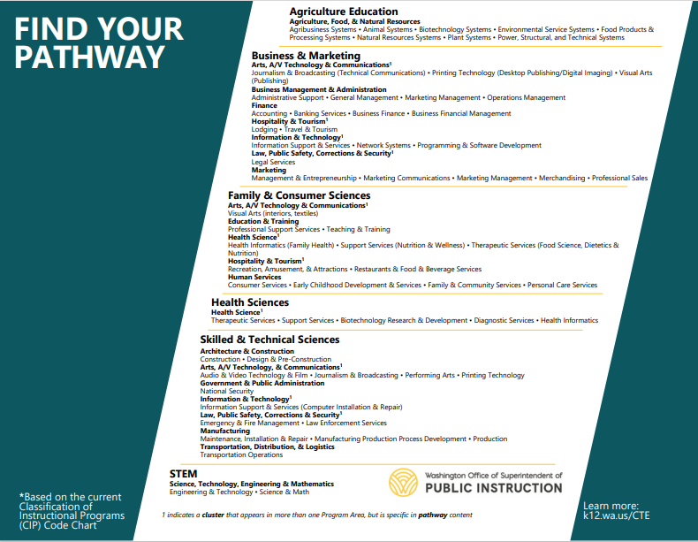
CTE Program Areas/Clusters/Pathways
Notes:
“Find Your Pathway” document identifies ALL the program areas, cluster sectors, and CTE pathways in the state of WA.
https://www.k12.wa.us/sites/default/files/public/careerteched/pubdocs/FindYourPathway-October2021.pdf

Slide 19
Notes:
Here is an example of a pathway in career development.
Career and college exploration and preparation is truly a K-12 experience we should give all students! :-)

Slide 20
Graduation Pathways

Slide 21
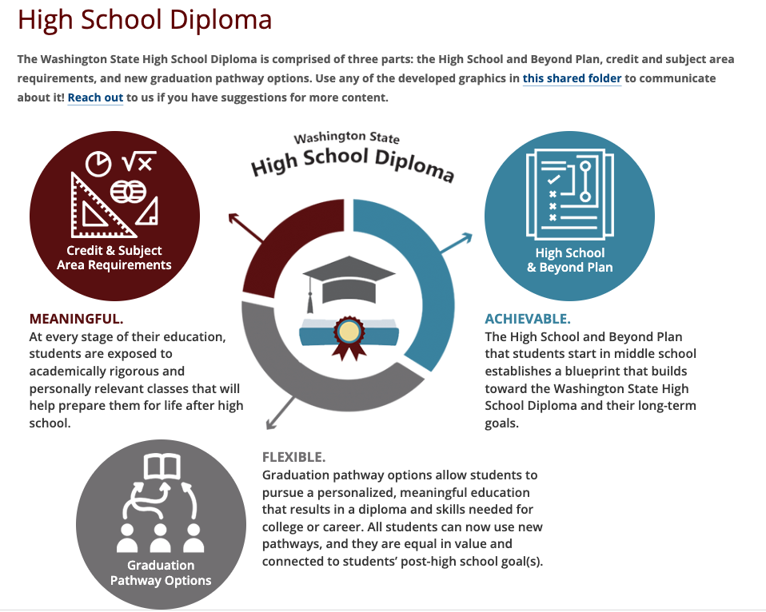
Shared folder of resources
Notes:
Shared folder of resources
HB 1308
New requirements for districts
The newly passed law includes adding a performance-based pathway and some other new requirements for school districts:
• School districts must annually provide students in grades 8-12 and their guardians with comprehensive information about the pathways offered.
• School districts must examine their local pathways data annually to see if there are any differences between groups of students in terms of who is participating in and completing the pathways offered. If there are differences, the district must identify why and make appropriate changes to ensure the options are equitably available to all students.

Slide 22
Graduation Requirements
+
+
=
HSBP
INSTRUCTION
(24-CREDITS)
GRADUATION PATHWAY
MEANINGFUL DIPLOMA
Notes:
MULTIPLE PATHWAYS TO GRADUATION (HB 1599)
Expands the ways WA students show their readiness for their next step after high school.
Students must have a High School and Beyond Plan, earn 24 credits and complete one of several different pathway requirements to graduate.
The new pathways are built off of things already in place that we believe in.
1599 clarifies and strengthens the role of the HSBP in helping students have agency in their HS career and ensuring that the courses they take and the pathways they choose line up with their goals for after high school.
High School and Beyond

Slide 23
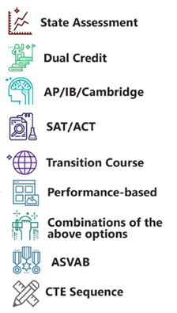
OSPI Graduation Pathways
Students with IEPs are general ed students first and should be given every opportunity to access CTE courses with support and accommodations, as needed
The inclusion of the new “Performance-Based” grad pathway should not become the default option for students with disabilities ~ that is a known concern voiced by staff and families who support students with disabilities (SWD)
The district should continue to provide support and resources for building CTE programs including what’s needed to ensure SWDs can continue to access them
Shared by Kim Reykdal
Graduation Toolkit
Notes:
Note: The WA-AIM is still an allowable graduation pathway for those very few students for whom an IEP team deems it to be the most appropriate option. The Certificate of Individual Achievement (CIA) is no longer an option for students who have an IEP.
CTE Sequence=CTE Graduation Pathway
The new pathways are built off of things already in place that we believe in.
First, the HB 1599 clarifies and strengthens the role of the HSBP in helping students have agency in their HS career and ensuring that the courses they take and the pathways they choose line up with their goals for after high school. See webinar from July 20, 2023; Visit Performance Based Pathway website
Example: Quilcene 8 of 18 used CTE graduation pathway to graduate
I am going to address:
-Dual Credit for CTE Courses
-Transition/Bridge to College courses – alternative to e.g. CTE
-*ASVAB – Armed Services Vocational Aptitude Battery Test - interestingly, different branches of the military require different ASVAB scores Current minimum scores for each branch of the military are: Air Force—31; Army—31; Coast Guard—36; Marine Corps—31; National Guard—31; Navy—31.
-CTE Sequence – when we began our work with rural schools, we found that many did not have any CTE courses let alone pathways – this then became an equity issue because students at those schools did not have access to one of the 8 state approved graduation pathways
-Performance-Based Pathway - HB 1308 The performance-based pathway allows students to show what they know and can do in real-world, hands-on ways that align with their individual goals for life after high school. This student-centered pathway is intended to be customizable, with the aim of being relevant and engaging to the student. There is a lot of flexibility as the learning experience: • May take a variety of forms Examples: project, practicum, work-related experience, community service, cultural activity • May result in a variety of student work that can be evaluated Examples: performance, presentation, portfolio, report, film, exhibit • May, or may not, be done as part of a class where the student also earns credit To meet the graduation pathway requirement, the learning experience must: • Provide evidence that the student meets or exceeds state learning standards in English language arts (ELA) and mathematics • Align with the student’s High School and Beyond Plan goals • Meet state requirements (rules to be developed) regarding the safety and quality of the learning experience and the assessment criteria for determining the student has demonstrated the learning standards
The performance-based pathway is combinable with other the ELA and math pathway options, meaning the student can do one pathway in ELA and another pathway in math. For example, a student could pass the state assessment in ELA and then focus their performance based pathway in math.
Local policy School districts must adopt a local policy that meets state requirements before offering the performance-based pathway option. Most school districts that are interested in offering this pathway will be able to offer it beginning with the Class of 2025. Some districts that have already laid groundwork may be able to begin with the Class of 2024. For example, districts that are already doing mastery-based learning and districts that have a local culminating project requirement may be able to develop this new pathway faster.
-Locally approved graduation pathways
The "Bridge to College" Transition Course may not be best choice for your students – students not thriving in HS tend to not thrive in "Transition Courses/Bridge to College" which is focused on college prep; why not give these students skill sets that are immediately applicable to employment and post-secondary education (trade school, apprenticeship, internship, community college, etc.)
Each of these terms are defined for you in the new Graduation Toolkit which is already under development, led by Kim Reykdal, Director of Graduation and Pathway preparation, Secondary Education and Pathway Preparation, kim.reykdal@k12.wa.us . You can always find the most current version of the Graduation Toolkit available on the OSPI Website under “Graduation”.
https://www.k12.wa.us/student-success/graduation
Graduation tool kit
https://www.k12.wa.us/sites/default/files/public/graduation/pubdocs/2022%20Grad%20Pathways%20Toolkit__Final_8.13.21.pdf
*ASVAB - More Information
Satisfying this graduation pathway option meets requirements in both English and math.
For a student who takes the ASVAB while in high school and earns at least the minimum score on the Armed Forces Qualification Test (AFQT) portion of the test (as posted on the State Board of Education (SBE) website) it may be used to meet the graduation pathway.
Students may also attain an AFQT score through the Pending Internet Computerized Adaptive Test (PiCAT). PiCAT scores must be validated at a Military Entrance Processing Stations (MEPS). For more information on the PiCAT steps, please visit the SBE website
ASVAB Career Exploration https://www.asvabprogram.com
Current minimum scores for each branch of the military are: Air Force—31; Army—31; Coast Guard—36; Marine Corps—31; National Guard—31; Navy—31. (Scores posted on September 1, 2021.)
ASVAB Career Exploration Program
ASVAB website
Service Specific websites:
Air Force
Army
Coast Guard
Marine Corps
Navy

Slide 24
Like all Graduation Pathways, the CTE Graduation Pathway option must be:
Aligned with the student’s HSBP
Built with the year after high school in mind
Equal in value and expectations
AND . . .

Slide 25
CTE Sequence Graduation Pathways
2 High School Credits in CTE courses
(State approved courses with identified CIP codes)
Same CTE Program Area OR locally approved sequence that crosses programs
Includes dual credit opportunity and/or leads to an industry- recognized credential
Or
Complete a Core Plus program
Sequenced progression of technical skills . . .
Notes:
FIND YOUR PATHWAY https://www.k12.wa.us/sites/default/files/public/careerteched/pubdocs/FindYourPathway-October2021.pdf
CTE Graduation Pathways are sequenced CTE courses, resulting in two or more HS credits of CTE (in the SAME Program Area), that include the opportunity to earn dual credit and/or leads to an industry-recognized credential.
Additionally, OSPI administers a process for reviewing and approving local graduation CTE sequences (including courses from more than one CTE Program Area), which can developed by individual districts, Boards, and/or CTE Advisory Committees. However . . . . LOCAL CTE Graduation sequences are intended to provide for local or regional industries and occupations, OR new and emerging occupations that may require a particular combination of technical skills, i.e. FORENSIC NURSING.
There must still be industry, job market, and labor data that validates the content sequence and aligns to related post-secondary opportunities. That is why standards for CTE Programs of Study and criteria for CTE Graduation Pathways include either dual credit (which demonstrates college readiness) and/or leads to an aligned industry-recognized credential (which demonstrates career readiness).
A LOCAL CTE Graduation sequence is NOT intended to create a new career pathway for each individual student, or a student who has taken an UNRELATED, UNALIGNED mix of CTE course content in which there is no PROGRESSION OF TECHNICAL SKILLS or doesn’t lead to an ALIGNED IRC . . . . or as an “alternative” pathway only for students with disabilities.
In May 2022, 8 (out of class of 18) Quilcene students will graduate because of the CTE pathway. (Admin canceled transition course, “Bridge to College” to support students in their areas of interest - CTE)

Slide 26
Notes:
Source: High Quality Career and Technical Education
https://www.k12.wa.us/sites/default/files/public/careerteched/pubdocs/2020%20Pathway%20Documents%20Final.pdf

Slide 27
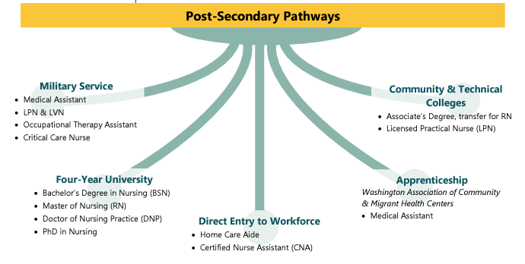
Source: High Quality Career and Technical Education
Notes:
Source: High Quality Career and Technical Education
https://www.k12.wa.us/sites/default/files/public/careerteched/pubdocs/2020%20Pathway%20Documents%20Final.pdf

Slide 28
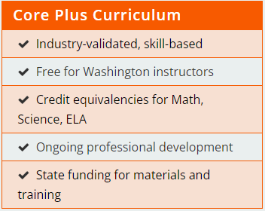
CTE Graduation Pathway:
Aerospace/Advanced Manufacturing
Construction
Maritime
Equivalency Credit
Can include science, 3rd yr. math, and/or ELA
Creates flexibility in student course selections
Industry
Certification
Embedded in courses
No cost
Recognized by Employers
Core Plus | Curriculum (core-plus.org)
Notes:
CORE PLUS: https://core-plus.org/
We’d like to mention another MODEL program within CTE . . . and that is the Core Plus Programs.
Core Plus programming also meets the definition of the a CTE Graduation Pathway from House Bill 1599. Currently, approved Core Plus programs include Aerospace/Advanced Manufacturing, Construction and Maritime career sectors.
Core Plus was designed to boost the number of Washington students graduating with knowledge in manufacturing and skilled trades.
Core Plus programs are considered model CTE graduation and program pathways because they incorporate CTE equivalencies and the opportunity for earning industry recognized credentials. There are also efforts underway to build in the potential to earn college credit through Core Plus programs as well.
Each program uses a curriculum that spans a two-year sequence covering up to 540 hours of instruction on basic knowledge needed in the manufacturing field (the “Core” part of the program) and another 540 hours on occupation-specific instruction in aviation, marine technology, construction, medical devices and agricultural mechanics (the “Plus” part of Core Plus).

Slide 29
Summary - Graduation Pathways
Special education educators can coordinate with the student, families/guardians and counselor to have to have the following graduation pathways reflected on IEP.
ACT or SAT
Dual Credit Course
Dual Credit Exams
Smarter Balance or WA-AIM
Transition Courses
Combination of any of the above to meet ELA and math
ASVAB (AFQT section)
CTE Course Sequence
Performance-based
Notes:
This information is provided by Kim Reykdal, OSPI
The WA-AIM is still an allowable graduation pathway for those very few students for whom an IEP team deems it to be the most appropriate option. It’s the Certificate of Individual Achievement (CIA) that is no longer an option for students who have an IEP.

Slide 30
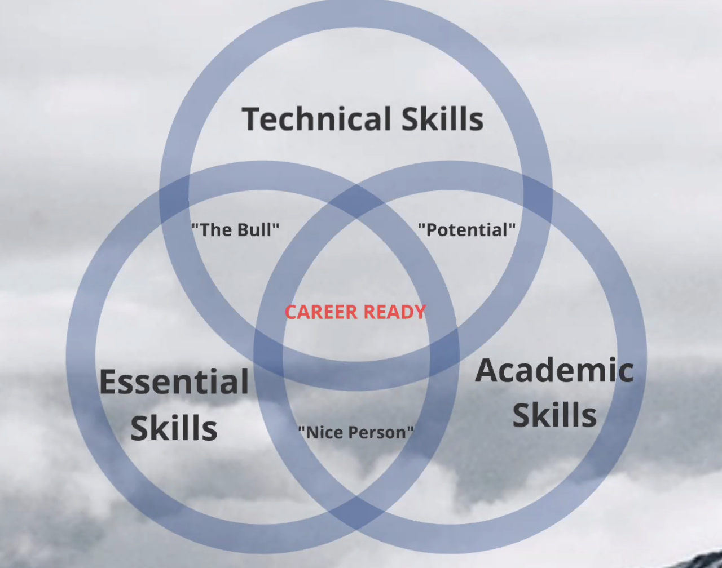
The Balanced Career – Career Tools and Information​
https://www.thebalancecareers.com/hr-career-advice-4161679
Source: Josh Davies, The Center for Work Ethic Development
Notes:
This is a picture of what a hopeful student could look like…
This is from Josh Davies Presentation to WACTA 10-18-21
The Balanced Career – Career Tools and Information
https://www.thebalancecareers.com/hr-career-advice-4161679
Important technical skills with examples
https://www.thebalancecareers.com/technical-skills-list-2063775
Technical skills are the abilities and knowledge needed to perform specific tasks. They are practical, and often relate to mechanical, information technology, mathematical, or scientific tasks. Some examples include knowledge of programming languages, design programs, mechanical equipment, or tools.
Essential Skills - employability skills…
Academic Skills - core math, reading and language arts skills needed to effectively work in the job industry
CAREER READY is the sweet spot.

Slide 31
High School and Beyond Plans
Informing high school courses and graduation pathways
Preparing students for life after high school
Notes:
We will discuss this under the auspices of student agency, hope and IEP/Transition Plans

Slide 32
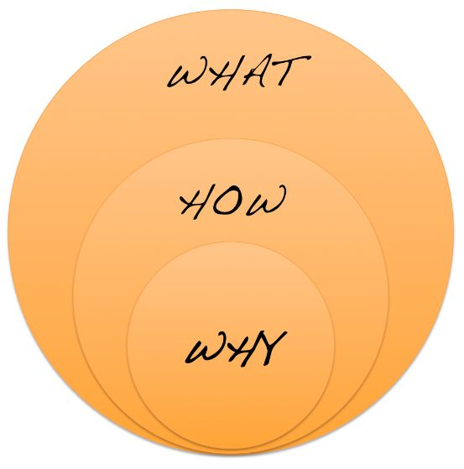
The WHY
High school diploma no longer sufficient
Global shift from industrial to knowledge economy
Increased need for postsecondary credentials
High-skill, high-wage and high-demand (H3) careers
800,000 jobs lost in 2008
Majority of new jobs created since then require post-HS education / credentials
7,000 students drop-out of high school every day
6.5 million young adults not in school or working
53% of recent college grads either underemployed or unemployed
Only 50% of all college students graduate with a post-secondary degree
58% of employers report that graduates are not adequately prepared for work
HSBP
HOPE
Source: Janet Brady, Former ACTE National Exec Director (2017)
Notes:
There are many statistics we can throw out that show our “why” in that we know our students need more robust, intentional, annual guidance to help them make course decisions that can lead to postsecondary options that will improve these statistics!

Slide 33
Build Student Hope & Increase Support
Notes:
There are a lot of expectations on counselors, educators, schools overall – consider the attrition rate..., it is so easy to get overwhelmed
My role is to support you...leverage/connect/braid resources that exist, we help create the space that is needed for people to get together

Slide 34
Graduation Pathways
& the HSBP
“The pathway options…provide a student with multiple pathways to graduating with a meaningful high school diploma that are tailored to the goals of the student.
A student may pursue one or more of the pathway options … but any pathway used by a student to demonstrate career and college preparation must be in alignment with the student's high school and beyond plan.”
Q
U
E
S
T
I
O
N
S
G
U
I
D
I
N
G
(HB 1599)
Notes:
The graduation pathway was the legislatures way of removing a high stakes exam as the way to demonstrate preparation for a postsecondary pathway, and now the High School and Beyond Plan takes on added significance as the framework in which to build each student’s pathway to their future.
The three guiding questions we use are intentional, and in this order for a reason ~ we must start with WHO they are as a person and who they want to be. Using tools to help them determine what careers match their interests, values, personality, strengths and skills is the second step in the process. The LAST step should be to determine what postsecondary path they NEED to pursue to prepare for their career…..

Slide 35
Collaboration is Essential: Build Your Team!
Counselors
Develop partnerships with ALL stakeholders
Stay current w/ current labor market trends and post-secondary opportunities
Create a career development goal that aligns with district’s mission and vision
Team teach career development lessons
Align HSBP guidance, pathway conversations and interest/skills inventories (STUDENT-driven)
Career Development should not be
done in a silo; it’s a district-wide focus!
Industry
Teachers
Students
Admin
OSPI Career Guidance Lesson Plans
Notes:
If you’re looking for robust HSBP implementation ideas, this slide links to the research I mentioned earlier about how staff delivery via advisory or homeroom can make a real difference in students’ career and college readiness. OSPIs report on the 2008-2016 College Readiness Initiative explains how schools across Washington with high populations of low-income students were able to increase college readiness through school wide implementation of career and college readiness supports.
This data shows a 20% increase overall in the % of students graduating eligible for a 4-year college, with significantly higher gains in several underrepresented student groups.
While this initiative saw positive outcomes across different student groups, there is still much work to be done to ensure that every student is being challenged and encouraged to achieve their potential.
% increase in student participation: 2008 to 2016:
MS Algebra: 22.1% to 28.6%
Advanced Math in HS: 60.7% to 80.8%
Chemistry in HS: 32.8% to 58.3%
Physics in HS: 10.8% to 21.6%
Increase in # students taking dual credit: 2010 to 2016
AP: 791 to 2,049 (159%)
RS: 180 to 307 (71%)

Slide 36
When, Who, Why and How?
 | HSBP (All students) | IEP Transition Plan
When | Starts in 7th or 8th grade | In the IEP year that the student turns 16
Who | Student-generated/student-facing Usually school counselor or advisor-facilitated | IEP Team
Why | State graduation requirement | Federal requirement (IDEA)
How | Reviewed/updated annually Guides course choices and school/community activities | Reviewed/updated annually Guides all activities of the IEP Measurable outcomes
Notes:
These two are more alike than different. The purpose of each is to provide a plan for achievement of post secondary goals with very distinct pieces that promote student choice and voice.
Inclusionary practices in CTE (Inclusive IEP’s for New World and HSBP 1/14/21) 28 Skills of Really Really Ready Students; Writing Effective Transition Plans

Slide 37
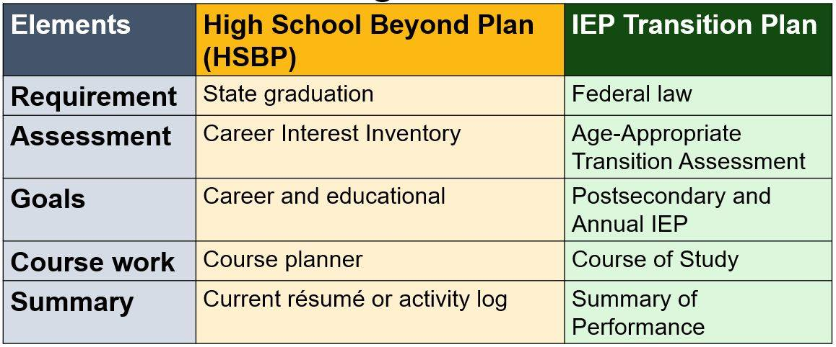
HSBP and Students Receiving Special Services
SPIN - Strengths, Preferences, Interests and Needs
T-Folio
Notes:
Age Appropriate Transition Assessment (Tool)
SPIN - Strengths, Preferences, Interests and Needs
IEP Team determination based on student, may need to be more than HSBP - timing is very important
Age appropriate Transition Assessment must be in place by age 16 - IEP team may reference the HSBP AND may include SPIN / additional info as related to students special needs, for example in the upcoming case study (page 24 Caleb’s case study), the student needed more robust assessment than what is HSBP
Key is to not duplicate work, but align it to HSBP
T-Folio https://www.cctstfolio.com/#/
Consider pictures for students who may need them and other modifications
Transition examples coming up will give you some examples.
Build off of HSBP and incorporate SPIN. (Caleb example)
This is NOT the Transition plan which is part of IEP
A student’s specialized IEP contains 5 core elements of the high school and beyond plan.
1. Goal - State graduation
2. Career interest inventory
3. Career and educational goals
4. Course work
5. Current resume or activity log

Slide 38
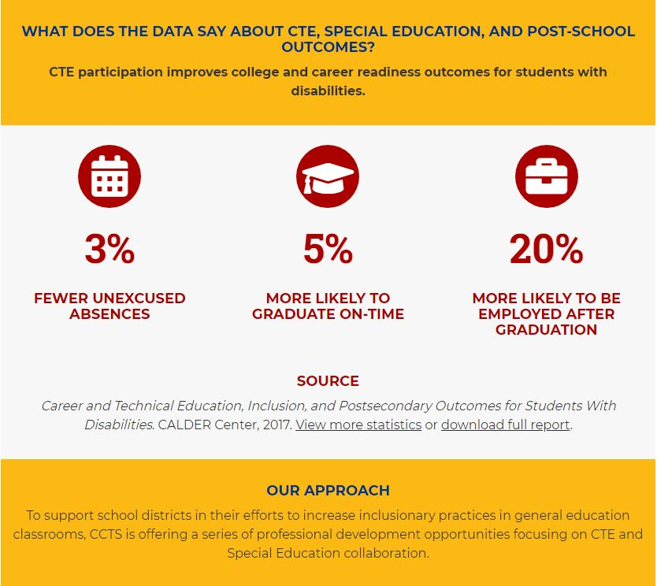
CTE Inclusionary Practices
Inclusive IEP’s for New World and HSBP 1/14/21)
28 Skills of Really Really Ready Students;
Writing Effective Transition Plans
Need Assistance?
Professional Development?
Alexandra Toney
alexandra.toney@k12.wa.us
OSPI Special Education Program Supervisor
Maria Muto
maria.muto@k12.wa.us
OSPI Secondary School Counseling Programming Supervisor
Notes:
One topic that came up over and over again is the number of barriers put in place around CTE courses that prevent students with disabilities from accessing them.
There is also much misunderstanding on the role of the IEP in supporting student graduation.
The numbers tell us…CTE is valuable to students with special needs
3% fewer absences
5% more likely to graduate on time
20% more likely to be employed after graduation

Slide 39
HSBP and Students Receiving Special Services
The IEP Transition Plan must align with the HSBP ~ it cannot take the place of the HSBP….
Guidelines for Aligning High School & Beyond Plans (HSBP) & IEP Transition Plans
Sample Exemplar HSBPs for Students with Disabilities (Appendix B)
Center for Change in Transition Services - Seattle University

Slide 40
Building hope and student agency includes:
- robust and intentional high school and beyond planning,
- a renewed focus on ensuring implementation of graduation pathways, and
- meaningful, relevant learning and career exploration/preparation experiences for students so that….
We see improved mental health and academic outcomes for ALL students, increased engagement of students, staff & families, and closing of gaps in postsecondary preparation when students exit our system.
Notes:
When students, led by their teachers, engage their families in this process…
The HSBP remains a hidden opportunity that must become a vehicle for connecting staff, students and families as we re-build connection with students and families and re-engage students in building hope for their future….

Slide 41
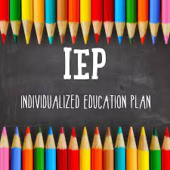
HSBP/IEP Case Studies

Slide 42
HSBP Case Study: Sherrie, 10th Grader
Case Study: HSBP & Aligned IEP: CTE Course Sequence
Showcases a CTE course sequence graduation pathway
Part of a larger document suite: Guidelines for Aligning HSBP and IEP Transition Plans
Guidelines for Aligning High School & Beyond Plans and IEP Transition Plans​
Case Study of a 10th grader using a CTE Course Sequence: Document | Webinar Recording| Slides
Notes:
https://www.k12.wa.us/sites/default/files/public/specialed/programreview/monitoring/secondarytransition/AppendixB-HSBP-Example-CTE.pdf
The two case studies we developed show how the IEP transition plan and the HSBP align to support two students, with different goals and different needs, to be ready for their next steps after high school.
The first case study we are going to go through today is Sherrie. She is using a CTE pathway to prepare for her career interests of graphic designer, but also to explore her second interest of computer programming.
I would like to draw your attention to the documents, webinar, and slides for this case study as linked above.

Slide 43
Sherrie’s Summary of Services Matrix
Service | Frequency | Location
Reading | 150 minutes/week | Special Education
Writing | 150 minutes/week | Special Education
Qualifying service areas:
Reading
Writing
Notes:
To get us started I wanted to share what Sherrie's Special Education Services look like, you can see that she is getting 150 minutes per week of special education support in reading and Writing. Her goals focus on using graphic organizers to enhance comprehension, The IEP (and HSBP) also as a wealth of information on the students’ strengths, preferences, interests and needs. This student is very driven, like to be a leader in activities and is most successful when working in applied and creative tasks.

Slide 44
Sherrie’s Personal Profile
Student-driven
Student-first language
Developed collaboratively with the students/young adults
Highlights student’s strengths, dreams, goals
Sherrie's HSBP: Personal Profile p. 3
Notes:
This is Sherrie’s individual personal profile. As you can see, it includes information from both middle school and high school indicating Sherrie’s interests, skills, values, goals, and needs. This document is student driven and student facing so Sherrie developed this content over time. Teachers and other adults involved with this process are simply guiding the process as the ownership and development of this document belongs to the student.
https://www.k12.wa.us/sites/default/files/public/specialed/programreview/monitoring/secondarytransition/AppendixB-HSBP-Example-CTE.pdf

Slide 45
Sherrie’s Education Goals and Plan
Postsecondary Education Goal
After graduation, Sherrie will enroll in a technical college or an art institute to study graphic design
Transition Services
Visit three technical colleges or art institutes and apply to school or schools of her choice no later than 12/1 of senior year
Apply for all possible financial aid and DVR eligibility for tuition assistance
Sherrie's HSBP: Education Goals and Plan p. 4
Notes:
This screen shot shows her education goals from the IEP transition plan on the left and from the HSBP on the right. Notice the IEP symbol the little magnifying glass in the corner because both the IEP transition plan and the HSBP state that Sherrie will enroll in a technical college or art institute to study graphic design.
Her IEP also states that she will get transition services to support this goal. These services include visiting three schools and getting support to apply to the school of her choice and support applying for aid and DVR eligibility. If you are following along this is found on page 4

Slide 46
Sherrie’s Career Goals
Postsecondary Employment Goal:
After graduation, Sherrie will be employed as a graphic designer
Transition Service:
Three job shadow experiences in graphic design company
Job preparation skills
Sherrie's HSBP: Career Goals p. 4
Notes:
Here you will the students career goal from the IEP on the left and the HSBP on the right again. You may also notice that Sherrie has completed a career interest assessment, and graphic designer was her top career, but she is also very interested in becoming a computer programmer. As we go through some of the following slides you can see how her school is supporting her explore and grow into both of these careers.
The career interest assessments - I would like to add here that there are multiple career exploration, interest inventories, and assessment platforms out there; as well as lots of related activities - both cost-based, web-based, and the best kind yet . . . . totally free!
Several are interactive, as well as grade-level specific, as pointed out under this "Career Goals" section. Many of you here today are familiar with these platforms—such as KidsKonnect, Kudor, Xello, Career Bridge, Career Cruising, CareerExplore, and even ASVAB; many schools will supplement these platforms with activities such as Career Day, Career Cafe, Careers on Wheels, and campus tours . . . lots and lots of different and great ideas.

Slide 47
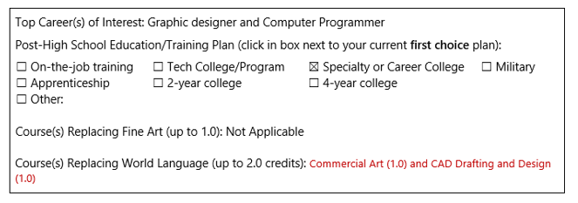
Sherrie’s Course Planner
For the two world language credits and/or second fine art credits, PPR allows students to choose courses that best fit their postsecondary goals.
HSBP Course Planner Example (p. 5)
Notes:
This chart shows the courses that Sherrie has taken over the course of her high school career.
The classes that are bolded in red text show 10 CTE courses that she will be taking. Her school team has provided some great course options that align with both her interest in graphic design and computer programing, and you may notice that some of these courses also count for not only CTE credit but also credits in course subject areas like science.
Lastly if you look at the left of this slide, I want to point out that since Sherries goals do not include attending a four-year university her team was able to use Personal Pathway flexibility to substitute the world languages courses for courses that better align with her post high school goal. These course include commercial art and CAD Drafting

Slide 48
Sherrie’s CTE Course Selection/Pathway Considerations
Meaningful courses
General CTE team considerations (leadership/extended learning connection to work based learning, collaboration)
CTE equivalencies - to meet subject area graduation requirements
Notes:
"Collaboration" really is key to planning a successful experience for the student. That process must be strategic, comprehensive and include individualized actions, rather than simply "checking the box". We know through data and reporting that CTE programs help students participate, complete, and transition to postsecondary more successfully: interest and relevance = engagement; but also fosters better attendance, lower discipline, and better outcomes.
Another reason that students often find more success in career programs--especially students with disabilities--is based within the foundational standards of our CTE pathways. Critical embedded components such as leadership activities, extended learning, work-based learning, industry guidance, family engagement, dual credit and industry-recognized credentials ALL contribute to the meaningful career AND college preparation for students. Consistent collaborations not only set up students for the best opportunity to succeed, but also can ensure equitable access for ALL students to these programs--and ultimately, better preparation, transition and outcomes.
Another component of CTE programs are CTE equivalencies that many out in the community and in support services are still learning about. CTE equivalencies are courses that align the academic content of core courses like math and science, with the technical content of CTE courses, so they become an advantage for students when earning required graduation credits. In this example, Sherrie is taking CTE courses that also count for Arts and an AP Computer Science Principles that counts for Science. Also, Sherrie has opportunity to take electives that are related to either of her top two career goals (Graphic Designer or Computer Programmer). All this combines to provide Sherrie TWO CTE pathways to graduation.

Slide 49
Sherrie’s Graduation Pathway
Notes:
So, we just talked about courses, let’s look at the student’s graduation pathway. The graduation requirements are the same for all students and there is flexibility within the pathways to support individual learn needs.
Here is a screenshot of page 8 if you are following along showing the students planned and in-progress graduation pathways. You can see here that Sherrie has planned to do two difference CTE course sequences to align with each of her career interests. She is currently "in progress" to meet her CTE course sequence to become a graphic designer and has already planned two additional courses here for her junior and senior year to prepare to be a computer programmer
You see the IEP symbol here because the graduation pathway should be aligned to his IEP transition plan goals and the graduation information in the IEP.

Slide 50
Sherrie’s CTE Sequence Graduation Pathway
Collaboration is key
CTE course sequences
Multiple combinations of courses could serve as CTE pathway
Locally approved sequence information
Notes:
At the risk of repeating this too often, Collaboration is so important. While the HSBP, most importantly, is student-driven, the adults involved in the process must also have the knowledge, tools and resources in order to provide the best guidance.
This section of the plan reflects how the student meets which graduation pathway--again, remember, the student can meet more than one and can combine different ELA and Math options; and note, in the case of CTE Sequence Grad Pathways and Sherrie’s example, she does not need to meet additional ELA and/or Math requirements.
Another thing I would like to point out is that the intentional design of CTE Pathways lends itself to meaningful outcomes for students . . . . the combination of course sequencing is a progression of skills and must align to careers and occupations that require these specific technical skills and abilities; further, incorporating industry-recognized credentials in the pathway means a seamless transitions for students—workforce entry, apprenticeship, or further education and training.
Another strong point I’d like to make as to why collaboration and meaningful planning remain key throughout a student’s plan. It is of no advantage to a student, especially in their senior year, to try and "make a round peg fit a square hole." Meaning, it is of no benefit for Sherrie to take a Foods class and a food handler’s permit if her career choice is to be a graphic designer; or to take accounting and a Quickbooks certification if she wants to be a computer programmer. This is not to say that, if Sherrie had room in her schedule or an interest in variety, she couldn’t take a different class(es) as elective, but why not guide her to related courses that could supplement her success and reinforce her specific career goals. A clear, meaningful "path" to her goal is a least 2 credits in a progression of skills with the potential for multiple equivalencies AND an opportunity to take industry-recognized credentials such as Adobe or C++ (as you can see in Sherrie’s example).

Slide 51
Sherrie’s Résumé
Notes:
Lastly, I want to briefly show what her Activity Log looks like. You can see she has a summary of strength and skills, and a log of the work and community experience she has gained while in high school. Sherrie, while only a 10th grader currently, has some excellent experience in the school and community working on the yearbook, designing a logo and volunteering at a childcare center. This template was updated over time as she gained new experiences and will be continued to add to as she progresses through high school.

Slide 52
HSBP Case Study: Kaleb, Adult Student with Transition Supports
Case Study: HSBP & Aligned IEP: Adult Student WA-AIM
Showcases a graduation pathway using the alternate state assessment
Part of a larger document suite: Guidelines for Aligning HSBP and IEP Transition Plans Document Suite
Guidelines for Aligning High School & Beyond Plans and IEP Transition Plans​
Case Study of an Adult Student using the WA-AIM: Document | Webinar Recording | Slides
Notes:
While we will not be going through all of Kaleb's HSBP Case Study I wanted to highlight some of the student specific activities that Kaleb had as part of his HSBP experience and how it helped him reach his goals
This Case Study is based on an IEP and HSBP received as part of SafetyNet, names and some content have been changed, but this is an exemplar from the field.
So, Kaleb is 20-year-old student who has Autism and Cerebral Palsy and has some intensive support needs.

Slide 53
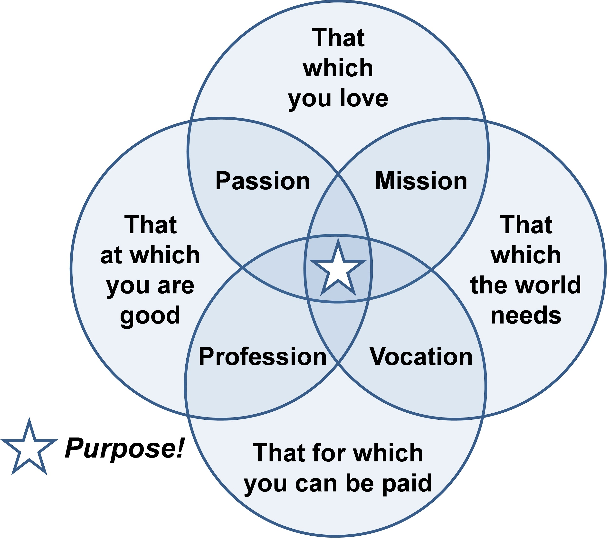
Notes:
Another way to visualize helping students “see” their graduation pathways and build a meaningful HSBP
All students CAN identify their goals and pathways to achieve those goals. We can encourage their way power/will power to achieve those goals and help them problem solve barriers along the way.
Students can envision their future and answer the question, Who am I and What am I supposed to contribute? (Purpose). They can align their passion(s) with purpose.

Slide 54
Kimberly Hetrick, Ed.D.
CCL Director, OESD 114
khetrick@oesd114.org
970.445.8958
Sign up for the OESD 114 Career Connected Learning Newsletter
Notes:
Newsletter sign up
https://docs.google.com/forms/d/e/1FAIpQLSd421U_Ti--vy-6KkYKYyecTS459xnBXJdKqAvCigLHf1y2tg/viewform?usp=sf_link
March 2022 OESD 114 CCL Newsletter
https://sway.office.com/i91q2HnTIQw6pGCB?ref=Link
Survey https://forms.gle/rCJSe3ZNY79dPkpF8

Slide 57
Resources
High School and Beyond Plan Template
Secondary Transition and HSBP
Please reach out with any questions on today’s content:
Tania.May@k12.wa.us – Special Education
Alexandra.Toney@k12.wa.us - Special Education
Maria Muto- Graduation
Notes:
https://www.k12.wa.us/student-success/graduation/graduation-requirements/high-school-beyond-plan
https://www.k12.wa.us/student-success/special-education/program-improvement/technical-assistance/secondary-transition
Thank you all for the time today. Please reach out with any questions on today’s content. You will notice we have the contact information shown here listed by our specific content areas, but we work together to answer and triage emails we receive.
The template we walked through today, as well as the webpage where you can find both case studies are linked within today’s slide deck.

Slide 58
Center for Change in Transition Services
CCTS is one of several agencies collaborating with OSPI as part of the Inclusionary Practices Professional Development Project.
CCTS Goals:
Increase inclusionary practices in general education, focusing on partnerships between Special Education and CTE
Promote positive shifts in student expectations and opportunities
Expand possibilities for CTE access
Develop meaningful, data-informed action plans for districts
Offer support and technical assistance from skilled transition specialists
Encourage systemic change in teacher practices
Measurements:
Increased CTE course enrollment of students with disabilities
Improved graduation rates for students with disabilities
Increased post-school engagement for students with disabilities.
Notes:
https://www.seattleu.edu/ccts/projects/inclusionary-practices/
https://www.k12.wa.us/policy-funding/special-education-funding-and-finance/inclusionary-practices-professional-development-project

Slide 59
Microsoft Autism Hiring Program
Microsoft Neurodiversity Hiring Program & FAQ
We built the Microsoft Neurodiversity Hiring Program on the belief that traditional recruiting does not allow individuals who are Neurodiverse to demonstrate their strengths and qualifications. Through this program, applicants engage in an extended interview process that focuses on workability, team projects, and skill assessment. Our process gives candidates the opportunity to showcase their unique talents while learning about Microsoft as an employer of choice.

Slide 60
Resources
•Escaping the Disability Trap: What’s the best way to prepare special-needs students for the workforce? The Atlantic
•Why CTE – ACTE
•Designing High Quality CTE Pathways
•CTE Program Areas/Clusters/Pathways
•OSPI Graduation Website
•Definitions of Work-Based Learning
Notes:
https://www.theatlantic.com/education/archive/2016/06/escaping-the-disability-trap/487070/
https://www.acteonline.org/why-cte/
https://www.k12.wa.us/sites/default/files/public/careerteched/pubdocs/2020%20Pathway%20Documents%20Final.pdf
https://www.k12.wa.us/sites/default/files/public/careerteched/pubdocs/FindYourPathway-October2021.pdf
https://www.k12.wa.us/student-success/graduation
https://drive.google.com/file/d/1S6eUDTDn--_gIDvYPiJ2HUIPIn_-ChTm/view

Slide 61
Resources
21st Century Skills-Employability Skills Framework
What is CTE?
CTE Myths and Facts
Programs of Study, Career Clusters, and Career Pathways
List of Statewide Course Equivalencies
Career and Technical Education, Inclusion, and Postsecondary Outcomes for Students With Disabilities
Notes:
https://s3.amazonaws.com/PCRN/docs/Employability_Skills_Framework_OnePager_20180212.pdf
https://cte.careertech.org/sites/default/files/documents/fact-sheets/What_is_CTE_2018.pdf
https://cte.careertech.org/sites/default/files/documents/fact-sheets/CTE_Myths_Facts_2020.pdf
https://www.k12.wa.us/student-success/career-technical-education-cte/program-study-career-clusters-and-career-pathways
https://www.k12.wa.us/sites/default/files/public/careerteched/clusters/courseequivalencies/Statewide%20Equivalencies%20revised%20July%202020.pdf
https://caldercenter.org/publications/career-and-technical-education-inclusion-and-postsecondary-outcomes-students

Slide 62
Financial Aid Student Resources
Washington College Grant: Apprentices in a participating program may be eligible to receive the WA College Grant for Apprenticeship.
College Bound Scholarship: An early commitment of state financial aid to eligible students and can be used at 65+ institutions in Washington.
1/19/2022 | ‹#›

Slide 63
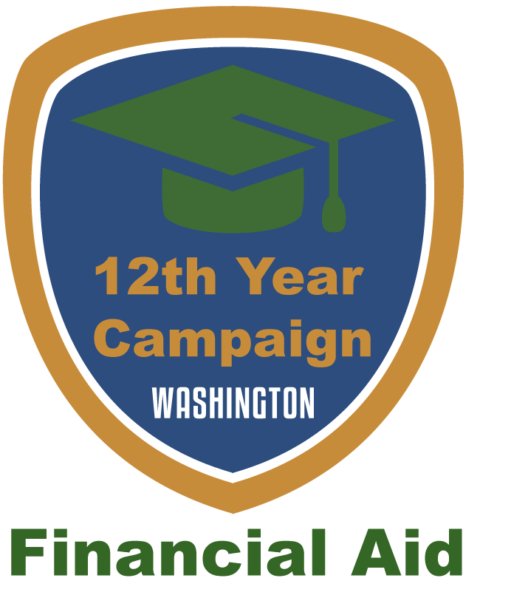
Resource: 12th Year Campaign (wsac.wa.gov/12th-year-campaign)
The 12th Year Campaign boosts college and financial aid application rates in Washington.
This page contains information and resources to help schools and partners with free financial aid training and free print and digital materials.
1/19/2022 | ‹#›

Slide 64
College and Career Pathways handouts
College and Career Pathways: An outline of potential postsecondary pathways.
College Means: What do we mean when we say college? Help students understand the diversity of the term.
How to Become an Apprentice: Help students interested in apprenticeships understand how to pursue this pathway.
Technical and Special Colleges: An overview of technical and specialty colleges.
Military Pathways: An overview of the different pathways related to joining the military.

Slide 65
LGBTQ+ and College Access: Supporting LGBTQ+ students through the admissions and financial aid process.
Youth in Foster Care: Supporting youth in foster care through the admissions and financial aid process.
Financial Aid and Unaccompanied Homeless Youth: Supporting unaccompanied homeless youth with the financial aid process.
Information on Student Loans: A brief overview of student loans.
1/19/2022 | ‹#›

Slide 66
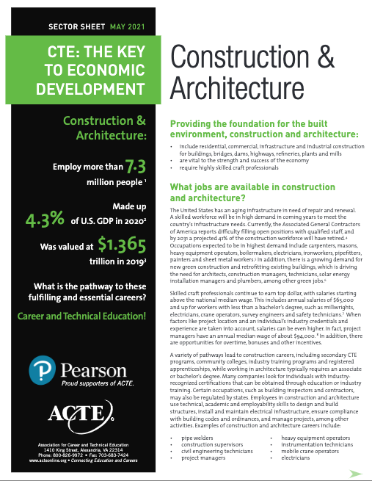
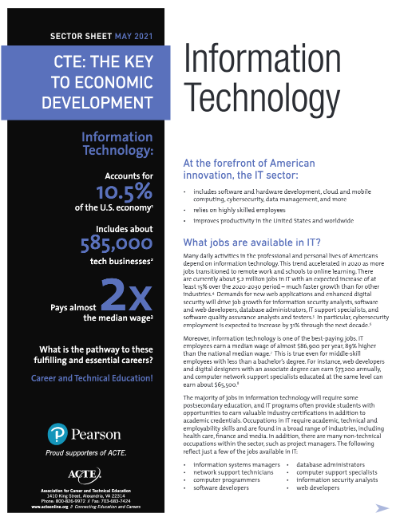
ACTE Sector Sheets (15)
Notes:
Sinead
CTE: The Key to Workforce Development for the U.S. Military & Veterans
CTE: The Key to Economic Development in Advanced Manufacturing
CTE: The Key to Economic Development in Aerospace and Defense
CTE: The Key to Economic Development in Agriculture, Food and Natural Resources
CTE: The Key to Economic Development in Arts, Media & Entertainment
CTE: The Key to Economic Development in Biosciences
CTE: The Key to Economic Development in Construction and Architecture
CTE: The Key to Economic Development in Education and Training NEW
CTE: The Key to Economic Development in Energy
CTE: The Key to Economic Development in Financial Services
CTE: The Key to Economic Development in Health Care
CTE: The Key to Economic Development in Hospitality and Tourism
CTE: The Key to Economic Development in Information Technology
CTE: The Key to Economic Development in Law, Public Safety, Corrections and Security
CTE: The Key to Economic Development in Transportation, Distribution and Logistics

Slide 67
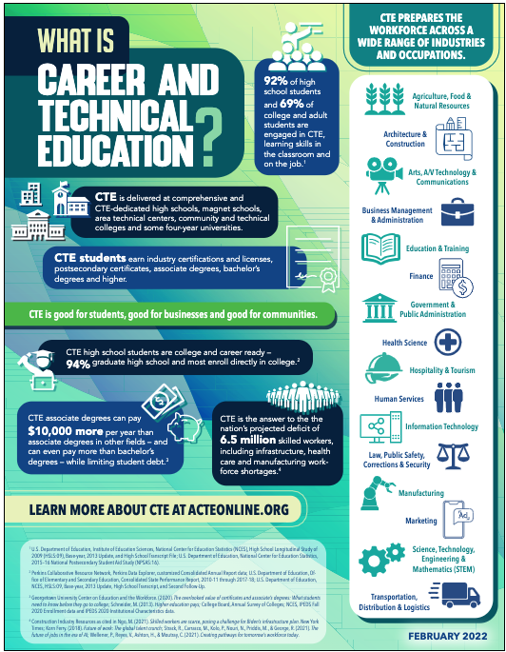
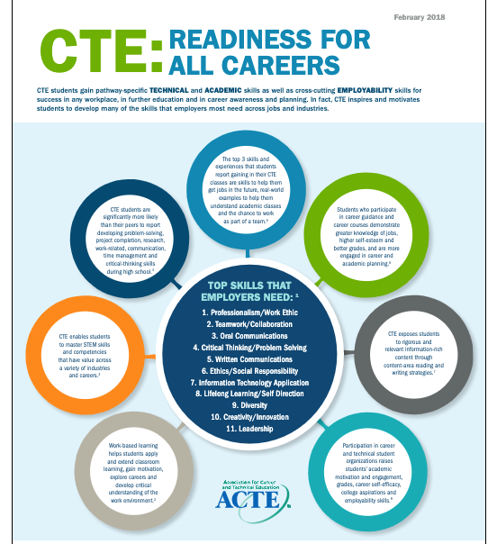
ACTE CTE Facts
Notes:
SINEAD
EMPLOYABILITY SKILLS FRAMEWORK
PERKINS COLLABORATIVE NETWORK RESOURCES
CAREER TECH WA
ACTE FACTS HTTPS://WWW.ACTEONLINE.ORG/WHY-CTE/WHAT-IS-CTE/BASIC-FACTS/
GENERAL FACT SHEETS & INFOGRAPHICS
NEW: What is CTE? (Use it to introduce people quickly to CTE) Overview of basic facts and benefits about CTE that will grab the attention of anyone new to CTE, including students and families; industry leaders; policymakers; and the media.
CTE Works! (Use it to demonstrate the value of CTE) Research overview of CTE’s impact on student academic achievement, dropout rates, adult workforce needs, earnings and employment outcomes, the skills gap and state economies.
What is a Credential? (Use it to explain the variety of CTE credentials) Overview of the different types of credentials that can be earned by students in CTE programs of study.
A Brief History of CTE (Use it to show the evolution of federal CTE policy) Describes how federal CTE policy has evolved since 1917, up to and including the Strengthening Career and Technical Education for the 21st Century Act (Perkins V).
Pell Grants & Short-term Programs (Use it to advocate for expanding Pell grants to high quality short-term postsecondary CTE programs) Provides evidence about how high quality short-term postsecondary CTE programs, paired with financial assistance, can lead to positive educational and career outcomes.
Investing in Career and Technical Education Yields Big Returns (Use it to show policymakers how investments in CTE will pay off for your community and state) Statistics from return-on-investment research of CTE programs across the country, showing that the economic impact CTE can have locally, statewide and nationally is enormous.
CTE: Readiness For All Careers (Use it to communicate how CTE prepares students with employability skills for a variety of careers and industries) Connects the general workforce skills that employers most need with research demonstrating how CTE helps students develop skills with value across industries and career fields.
CTE Improves Student Achievement in High School, College and Career (Use it to communicate with families) This infographic co-created with National PTA describes the benefits of CTE to parents and guardians.

Slide 68
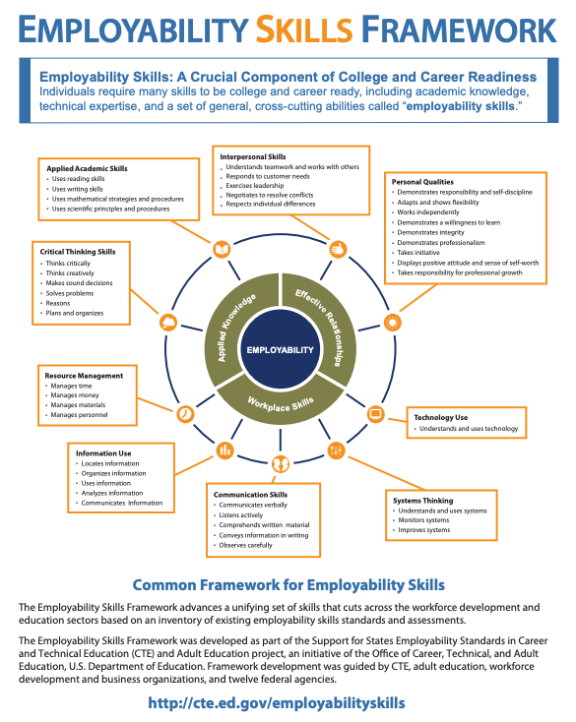
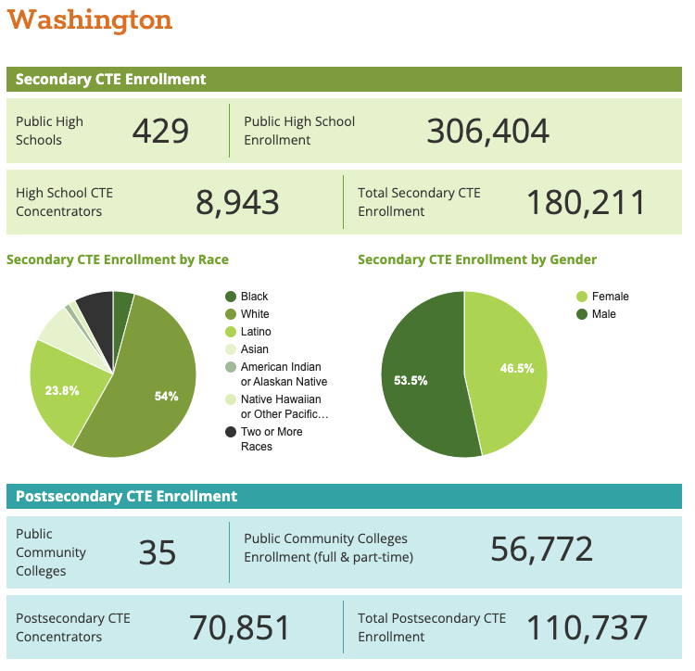
Notes:
https://s3.amazonaws.com/PCRN/docs/Employability_Skills_Framework_OnePager_20180212.pdf
https://careertech.org/washington

Slide 69
Resources from Kimberly – All in progress
Career Connected Learning Elementary Resources
Career Technical Education (CTE) Resources
CTE and CCL Resources for Special Populations
WA CTE Glossary of Terms and Need to Know
Career Choices and HSBP Resources
Notes:
I have created these resources based on requests from stakeholders - at meeting just like this one - please know that, while not well organized, there are many resources here and I continue to add to these lists.
Career Connected Learning Elementary Resources
https://docs.google.com/document/d/1L4TfV9S2JYzSuAVvC-vYyypFbjAywLnIfaBtbddjTGg/edit?usp=sharing
Career Technical Education Resources
https://docs.google.com/document/d/1Rj1l6NIfazLKISE3LQUG1kr8fpqgvZi-dGd2Acj-qMs/edit?usp=sharing
CTE and CCL Resources for Special Populations
https://docs.google.com/document/d/1JZYux-kMhZrDJyeYX0BZw88SkRWrCPt4xTvsGaBilUI/edit?usp=sharing
WA CTE Glossary of Terms and Need to Know
https://docs.google.com/document/d/1Z4N2vkkuYBQu_A-4A-jrDiplbpeF5oSKTXeT6fsqdmE/edit?usp=sharing
Career Choices and HSBP Resources
https://docs.google.com/document/d/1FtAneF68rwThlXADPnErKr4Ik3-fFb2AMgIrVa2DZNY/edit?usp=sharing

Slide 70
New Resource Highlights How States Use American Rescue Plan Funds to Reengage Students through Career and Technical Education
Feb 25, 2022, the U.S. Department of Education released a new fact sheet highlighting ways states and school districts are using American Rescue Plan funds to reengage students and enhance academic learning by expanding career and technical education (CTE) opportunities.
As schools help students address lost instructional time, high-quality CTE programs can be a powerful tool to boost school engagement and on-time graduation.
"Expanded pathways from high school to the workforce can help students gain the skills and earn the credentials needed for high-growth jobs, including those that don't require a four-year college degree." Secretary of Education Miguel Cardona
Students who complete a sequence of CTE courses in high school are more likely to graduate on time and enroll in postsecondary education.
A new Homeroom blog post for students, families and educators details how CTE programs prepare students for in-demand career pathways by providing opportunities for hands-on experiences and instructional time
Notes:
https://www.ed.gov/news/press-releases/new-resource-highlights-how-states-use-american-rescue-plan-funds-reengage-students-through-career-and-technical-education?utm_content=&utm_medium=email&utm_name=&utm_source=govdelivery&utm_term=

Slide 71
“Hope Rising will be an important source of help to those seeking to find ways to reduce the impact of adverse childhood experiences in order to live thriving, hope-filled lives. Dr. Chan Hellman and Casey Gwinn are the first researchers and authors to connect higher Hope Scores with reducing the impact of violence, trauma, and abuse. The potential benefit of implementing the science of hope throughout society is enormous if we truly want to meet the needs of the currently unrecognized multitudes of trauma-exposed adults and children.”
Dr. Vincent J. Felitti

Slide 72
Hidden Brain – Podcast: “What is not on the test”
Comparison between HS Diploma & GED
No difference in IQ
Statistically different lifelong health & wellbeing:
Better Physical & Mental Health
Better Relationship Stability
Better Economic Security
Reduced Criminal Activity
14% ROI – High quality SEL Education; Parent Ed (Perry PreK Project)
Notes:
https://www.npr.org/2019/05/09/721733303/whats-not-on-the-test-the-overlooked-factors-that-determine-success
To learn more about Hope and the Brain

Slide 73
Hope for Homies (thanks for joining us Neaner!)
Chan Hellman's Hope TedTalk (20 minutes)
Additional Reading Materials Folder (includes Chocolate Chip and Radish, Mindfulness and Hope, Ginwright's blog, etc.)
Cause I Ain't Got a Pencil poem
Shawn Ginwright's books: Hope and Healing in Urban Education and The Four Pivots
Oldenburg Burnout Inventory
Kitsap Strong Hope Toolkit
List of Hope Publications
Hope Scales (Child and Adult)
Hope Scale (Spanish)
Project Implementation Goal Worksheet
Project Implementation Pathways Worksheet
Hope Science Resources
Courtesy of Kitsap Strong/Graduate Strong Hope Science Workshop with Dr. Chan Hellman

Slide 74
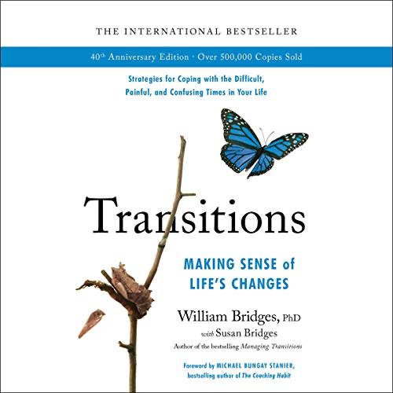
Transitions: Making Sense of Life's Changes
Whether you choose it or it is thrust upon you, change brings both opportunities and turmoil.
Since Transitions was first published, this guide has helped thousands cope with these issues by providing an insightful road map of the transition process.
Takes readers step by step through the three stages of any transition: The Ending, The Neutral Zone, and, eventually, The New Beginning.
Notes:
Transitions
https://www.amazon.com/Transitions-Making-Sense-Lifes-Changes/dp/B081TMW8JW/ref=sr_1_1?gclid=CjwKCAiAvOeQBhBkEiwAxutUVC0zsV4sKlBZOlFN0NMvREEAGOOKf7Lc8L-IhSv-LKKs3Ksvqfi4AxoCLX4QAvD_BwE&hvadid=241629672394&hvdev=c&hvlocphy=9033469&hvnetw=g&hvqmt=e&hvrand=10028810086944395091&hvtargid=kwd-1134048722&hydadcr=22567_10355148&keywords=transitions+william+bridges&qid=1645894056&sr=8-1
The best-selling guide for coping with changes in life and work, named one of the 50 all-time best books in self-help and personal development
Whether you choose it or it is thrust upon you, change brings both opportunities and turmoil. Since Transitions was first published, this supportive guide has helped hundreds of thousands cope with these issues by providing an elegantly simple yet profoundly insightful road map of the transition process. With the understanding born of both personal and professional experience, William Bridges takes listeners step by step through the three stages of any transition: The Ending, The Neutral Zone, and, eventually, The New Beginning. Bridges explains how each stage can be understood and embraced, leading to meaningful and productive movement into a hopeful future. With a new introduction highlighting how the advice in the audiobook continues to apply and is perhaps even more relevant today, and a new chapter devoted to change in the workplace, Transitions will remain the essential guide for coping with the one constant in life: change.

Slide 75
The Adaptable Mind
Notes:
Open/flexible mindset

Slide 76
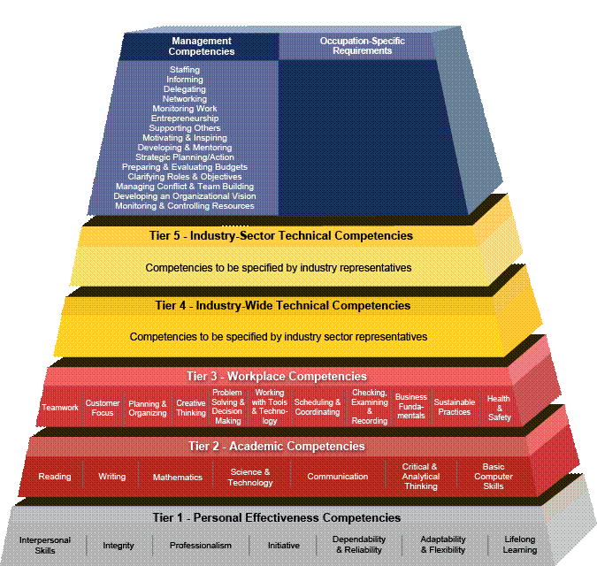
Career Competency Models
http://www.careeronestop.org/CompetencyMode

Slide 77
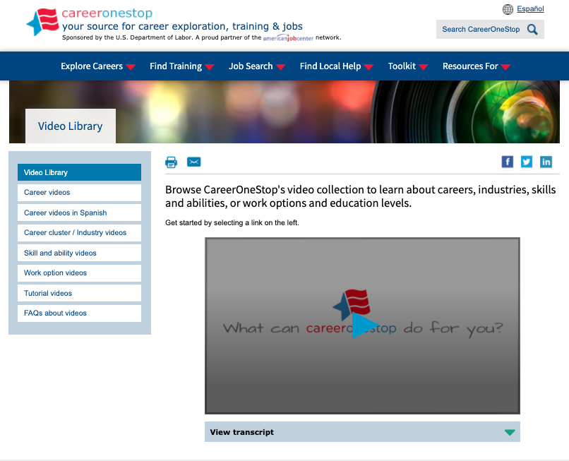
Videos available in English AND Spanish!
Career One Stop

Slide 78
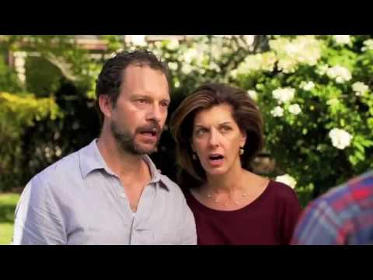
The NON Example
The Four Year Plan

