Slide 1
Promoting Partnerships Leading to Positive Postschool Outcomes
Dr. Mary E Morningstar
WTP/MEGI Summer Institute
2023

Slide 2
Who’s in the room?

Slide 3
National Technical Assistance Center on Transition: The Collaborative
https://transitionta.org/
Create an Account NOW!!

Slide 4
How do you define interagency collaboration?

Slide 5
Interagency Collaboration Operationally Defined for Transition
Clear, purposeful and carefully designed process promoting cross-agency, cross-program and cross-disciplinary collaborative efforts … leading to tangible transition outcomes.
State interagency teams addressing policies
Formal & informal agreements re: providing services, roles and responsibilities
Vision and mission
Organizational structure: membership, meeting times
Sharing resources (blending funding)
Resource mapping and addressing gaps
Shared problem solving
Communication and information sharing
Joint professional development
From: Rowe, et al., (2014). A dephi study to operationalize evidence-based predictors in secondary transition. CDTEI.

Slide 6
Outcomes of Collaboration
Aligned resources and decreased duplication of service development and delivery
Increased family engagement during transition planning
Youth with LD who receive 4 VR services are 4X’s more likely to obtain employment
Alignment of IEP and IPE goals
Increased student led IEP meetings and enhanced self-advocacy skills
Increase in students achieving competitive integrated employment after high school
Increase in students participating in post-secondary training and education
Notes:
Additional research tells us young people with learning disabilities who received an average of 4 VR services are 4 times as likely to obtain employment compared to peers with learning disabilities receiving only 1 VR service (Poppen et al., 2017)

Slide 7
Notes:
Young man with brown skin and short black hair leaning on his hand. He has a big smile. He is sitting in study lap with a notebook and smartphone in front of him.

Slide 8
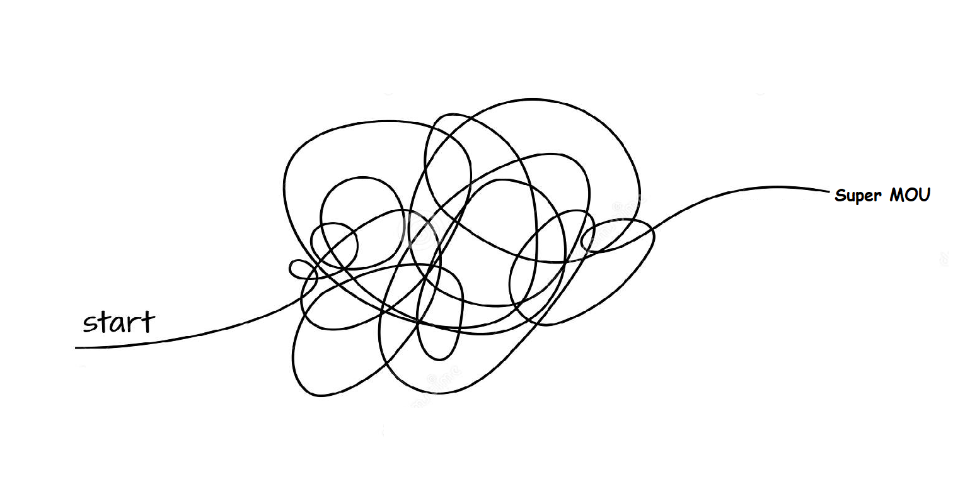
So how do you get started?
Collaboration

Slide 9
Interagency Collaboration: Key Component in Secondary Transition
When students with disabilities access collaborative services during high school, they are more likely to experience positive post-school outcomes.
(Noonan, Gaumer-Erickson, & Morningstar, 2013; Test, Mazzotti, et al., 2009)

Slide 10
School-Based Strategies
Scheduling and staffing
Early planning
Flexibility in location of services
Administrative support
Follow-up after transition
Noonan, P.N. & Morningstar, M.E. (2012). Effective strategies for interagency collaboration. In M.L. Wehmeyer & K.W. Webb (Eds). Handbook of adolescent transition education for youth with disabilities. Routledge, Taylor & Frances Group.
Notes:
Scheduling and staffing
primary role of the transition coordinator was to work closely with multiple agencies, and often parents, in order to initiate and secure adults services
it was discussed that secondary special education personnel should not be the primary coordinator of transition services
argument for formalized trans coord role
One transition coordinator said, “There is no way you can sit in a classroom and teach and coordinate and network in the community. You can’t do both, and that’s why it’s important that your transition coordinator serves a role different than a classroom teacher.
Flexible scheduling and staffing to work evenings, weekends with agencies and families
No set coursework
Early planning
Early planning happens when linkages and training for students prior to their junior year in high school to make a smooth transition to adulthood.
Many districts began during middle school (7th grade)//often school-based (coursework, guest lecturing, meetings, and field trips)
recent legislation in one State “mandates long-range career planning for all students in grades 8-11”
Flexibility in location of services
School staff worked outside of schools, and agencies were allowed into schools
shared work space (VR on-sight at high schools)
community-based instruction (mall program and 18-21 programs in community colleges)
meeting locations (family homes or agencies)
Administrative support
A transition coordinator commented, “When special education directors aren’t involved, that collaboration doesn’t happen.”
administrative support was essential for interagency collaboration to occur
Administrators provided opportunities for collaboration by allowing flexible scheduling, compensation time, paid summer training, and substitutes
Follow-up after transition
Many transition coordinators were concerned about where their students end up, and went out of their way to collect data.
One transition coordinator commented: Once they [students] are out of school, we call at least every two months for the first six months, and then it drops down to every three months, every six months, just to make sure that they’re [agencies] are following through and doing what needs to be done.
However, some didn’t know what to do with the data on a larger scale…they just personally wanted to know in the linkages were successful, and if not, were willing to help

Slide 11
Strategies for Bridging School & Community
Use a variety of funding sources (supplementing services)
Building relationships
Advocacy
Ongoing meetings: shared problem-solving, goal-setting, effort from all
Transition Councils/Community Teams
Sharing information
Meeting with students and families
Training students and families
Transition portfolios
Noonan, P.N. & Morningstar, M.E. (2012). Effective strategies for interagency collaboration. In M.L. Wehmeyer & K.W. Webb (Eds). Handbook of adolescent transition education for youth with disabilities. Routledge, Taylor & Frances Group.
Notes:
Funding
High performing districts shared funding with a variety of agencies to improve services and training and tapped into external grant opportunities
Examples of shared funding & seeking out grants
LEA and Vocational Rehabilitation [VR] shared costs of a summer work program for 30-36 students
LEA shared costs with VR and Mental Health for community-based work sites
LEA and Workforce Investment Act [WIA] provider shared costs for a staff person for a community employment program
LEA and VR shared cost of blended staff position
LEA and Center for Independent Living [CIL] shared costs of transition fair.
Building Relationships: Clear value & positive attitudes toward relationship building
One transition coordinator commented, “It’s the network piece—making sure that you know where people are and knowing the people in different agencies, and being able to call on them and say ‘Hey, can you help me out, Ive got a student.’”
Common attitudes : (a) accommodating adult agencies, (b) learning their needs and limitations, (c) sharing resources, and (d) teamwork
One administrator said, “Once a community reaches that level [high collaboration], an outgrowth of that is you get to a culture of commitment and all of a sudden, agencies are making suggestions [to LEA], employers are making suggestions, and it goes far beyond the scope of one individual. It almost feeds on itself.”
Valued knowledge of adult agency priorities and needs
One transition coordinator said, “You know we meet as a team and we’re always looking for different collaborative efforts to meet transition needs…when you get into collaboration, different agencies have different priorities, so it’s identifying those mutual priorities.”
TCs valued the relationship longevity
Relationship Building Strategies:
--Advocacy
LEA and SEA expressed “feeling empowered” to facilitate improved interagency collaboration
TCs: challenged adult agencies (VR, DD, MH)// developed new programs for unmet needs (community based assessment at workplaces)
SEA: sought supportive legislation and new funding sources//advocated to superiors
--Ongoing meetings
Ongoing meetings with agencies
also frequented community organizations, such as the Chamber of Commerce, Rotary Club, and the Optimist Club
- shared problem-solving and goal-setting, joint training and high levels of effort from all sides.
--Transition councils/community teams their transition councils as a place for networking
Training students and families on adult agency services
TCs valued providing information and training to students and families regarding adult agency services, employment, and postsecondary education.
Info for students & Families was provided primarily through school-based classes, agency presentations, and community-based programs
Examples (a) agency staff visited classes for Juniors to explain about available programs, (b) VR supervisor presented quarterly to students classes, (c) employer provided training session at corporate site for students twice a year, (d) agencies (mental health and a center for independent living) provided a life skills course for students, and (e) a university offered two-week summer camp for youth with disabilities.
Information was provided to families primarily through transition fairs or conferences, parent visits to agencies, and ongoing agency parent trainings.
Transition portfolios vehicle for communicating assessment information, transition coursework and experiences, and key documentation to adult agencies.
One transition coordinator commented, “The portfolio approach is probably the most tried and true carry-along documentation that we could possibly put together…it’s the most perfect tool you might say for presenting oneself to the world.”

Slide 12
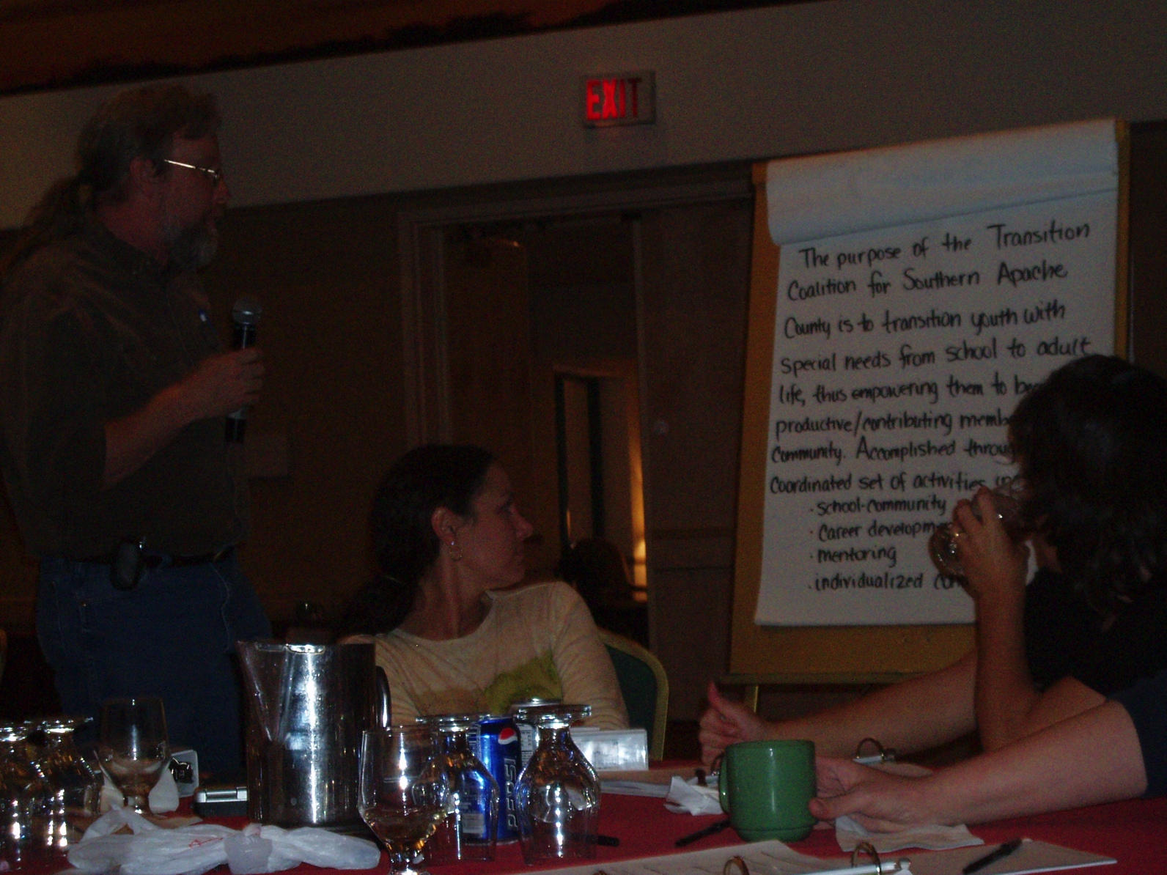
Community Strategies
Jointly train staff
Form community transition teams/councils
Jointly disseminate information to families and students
Noonan, P.N. & Morningstar, M.E. (2012). Effective strategies for interagency collaboration. In M.L. Wehmeyer & K.W. Webb (Eds). Handbook of adolescent transition education for youth with disabilities. Routledge, Taylor & Frances Group.
Notes:
Joint training of staff
Joint training--people from various affiliations training together for a common purpose
People included were LEA staff (educators), adult agency representatives, families, and related services school-based staff.
Joint training promotes relationship-building and knowledge-building.
Common practices included: (a) education-sponsored events frequented by multiple agencies; (b) educational staff attended adult agency training sessions; and (c) training events were jointly planned and supported.
One transition coordinator noted: We have an annual …conference which originally was just a Department of Education kind of thing, and it has branched out to encompass all the other agencies in terms of planning and preparation and who participates, who’s invited, and who presents, so it’s truly interagency collaboration.
Meeting with agency staff and transition councils
regularly scheduled meetings between the LEA and adult agency staff--weekly to quarterly
purpose-- sharing agency/LEA info and individualized student planning
A transition coordinator said “we get all the agencies to come to that meeting, and we discuss each 11th grader, but without actually saying their name…we brainstorm what ideas we have [for future services].” Another transition coordinator said, “You’ve got to invite them to meetings. You’ve got to go to their place. They’ve got to come to your place, and you’ve got to break bread together…it’s a leadership approach.”
Transition councils--prevalent format for ongoing meetings between transition coordinators, adult agencies, community organizations, parents, and students
A transition coordinator said that transition councils “are really important because it keeps those lines of communication open and it helps develop those relationships…I think it’s imperative that we understand each other’s work.”
Effective transition councils are action-oriented-- youth transition conferences, transition fairs, parent trainings and resource guides.
Often SEA supported
Disseminating information widely
Concerned with providing information to parents and students about adult agencies
Did this through products, local-level interagency groups, websites, mailings and presentations.
General examples: agency resource guides, manuals on navigating the adult service systems, checklists of potential agencies to contact, and websites for families, students, and agencies
LEAs also disseminated information through interagency groups, mailings and presentations.
Examples:
LEA sent out mass mailing twice a year inviting parents and students to training on connecting with agencies
LEA interagency transition council presented to community organizations (e.g., Rotary and Chamber of Commerce)
LEA distributed resource manuals to students and families via CD-Rom, paper, and websites
LEA videotaped agency presentations to share with students and families.

Slide 13
Attitudes
Clear value of relationship building
Culture of Commitment
Relationship-Building Strategies:
Getting to know one another
Working on goals/activities together
Joint Advocacy
Ongoing meetings
Transition councils
Noonan, P.N. & Morningstar, M.E. (2012). Effective strategies for interagency collaboration. In M.L. Wehmeyer & K.W. Webb (Eds). Handbook of adolescent transition education for youth with disabilities. Routledge, Taylor & Frances Group.
Notes:
Clear value of relationship building
Building collaborative, trusting relationships with adult service providers
One transition coordinator commented, “It’s the network piece—making sure that you know where people are and knowing the people in different agencies, and being able to call on them and say ‘Hey, can you help me out, I’ve got a student.’”
Common attitudes included: (a) accommodating adult agencies, (b) learning their needs and limitations, (c) sharing resources, and (d) teamwork
One administrator said, “Once a community reaches that level [high collaboration], an outgrowth of that is you get to a culture of commitment and all of a sudden, agencies are making suggestions [to LEA], employers are making suggestions, and it goes far beyond the scope of one individual. It almost feeds on itself.”
Relationships developed through: shared problem-solving and goal-setting, joint training and high levels of effort from all sides.
Relationship Building Capacity: Positive Attitudes
TCs highly committed //critical element of their role
Valued knowledge of adult agency priorities and needs
One transition coordinator said, “You know we meet as a team and we’re always looking for different collaborative efforts to meet transition needs…when you get into collaboration, different agencies have different priorities, so it’s identifying those mutual priorities.”
some TCs viewed LEA as agency
TCs valued the relationship longevity

Slide 14
What is the most collaborative way to supplement what schools are doing & how can VR support this effort?
Map out services to determine IDEA transition services that are currently being provided by the LEA, and new/enhanced services VR can provide
Discuss the sequence of these services
Determine the individual needs of the student (i.e. attend IEP meetings, etc.)
Coordinate goals and objectives in the IEP with student’s projected post-school employment outcome and Pre-ETS services in the IPE
Determine what Pre-ETS the student needs
Notes:
Okay, so now hopefully you have a better understanding of how to identify those Pre-ETS activities that VR might be able to provide and how those activities can be cross walked with LEA transition services to help ensure you are not duplicating or supplanting the services the school should be providing.
Now what the heck do you do with that information, and how do you use this information to help determine what the student needs? You gotta start mapping it out!
You need to sit down with your point of contact(s) at the LEA and discuss what IDEA transition services the student is currently receiving, and will be receiving in the future in accordance with their IEP; and then determine what additional Pre-ETS services the student needs that VR can provide or coordinate that will enhance the services the student is already receiving. You also need to think about the sequence of when these services will be provided, based upon the student’s individual needs, and coordinate those services with the goals and objectives in the students IEP, as well as the student’s projected post-school employment outcome, if they have been determined eligible for VR services.

Slide 15
Why It’s So Confusing!
Outlines
Definitions of transition services
Target populations
Nature, scope and purpose of services
Description of activities and services
Reservation of funds
https://transitionta.org/sidebyside/
Notes:
Count off A, B, C, D
Read that page(s)
Discuss with others

Slide 16
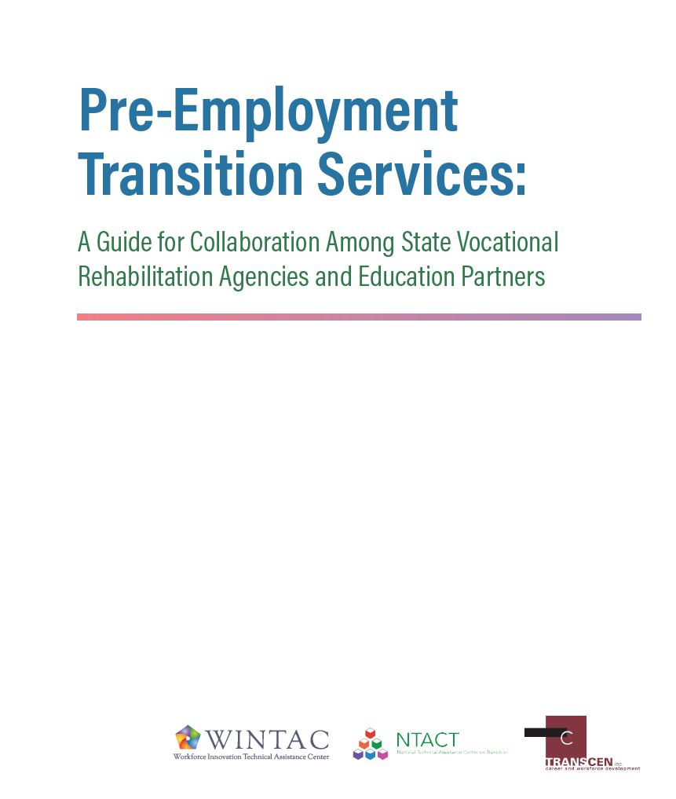
Developing Local Partnerships
https://transitionta.org/wp-content/uploads/docs/guide_interagency-collaboration-NTACTC.pdf
Notes:
Kelli to kick off

Slide 17
Developing Local Partnership Plans for Employment Outcomes
How will transition services and Pre-ETS be implemented locally?
How will planning for individual students take place?
How and when will agencies share student information?
Are other service providers delivering Pre-ETS? How are these coordinated?
How does VR and the School work together to coordinate outreach to students and families regarding VR Services

Slide 18
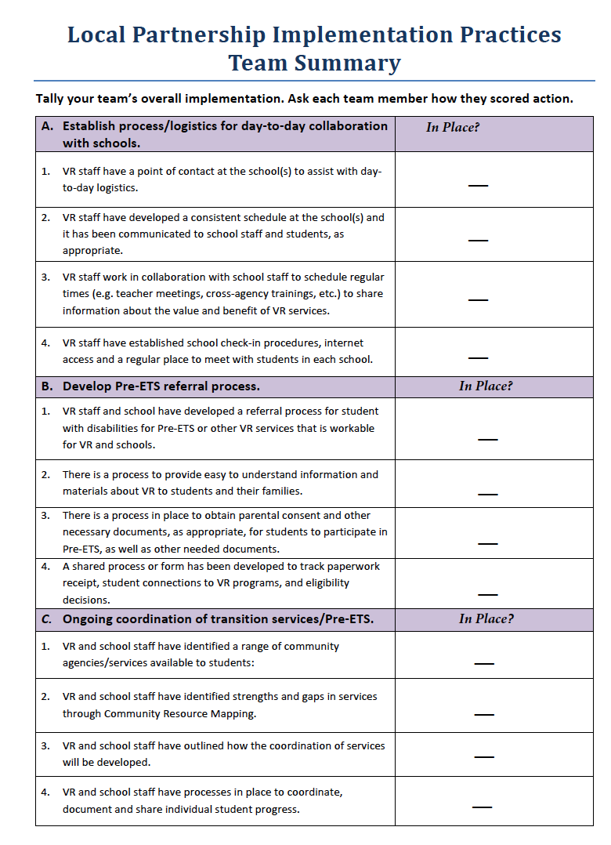
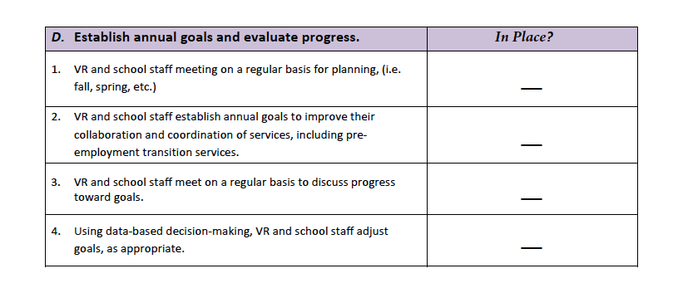
How is your Team (VR/School/Community) Doing with Partnerships?

Slide 19
A. Establish Process & Logistics for Day-to-Day Collaboration
Identify the point(s) of contact for Districts and VR Offices
Identify who is assigned School/VR contact for each school
Identify common student outcomes (integrated competitive employment, postsecondary education, etc.)
Location for VR to meet with students for Pre-ETS
Schedule of when VR will be meeting with students (see start of school year checklist)
What are good times for educators to meet with VR and vice versa
What is the students’ schedules?
Notes:
Things to consider when developing the schedule:
• Needs of school/students and VR counselor schedule
• Schoolwide and specific student schedules including assemblies, sports, family nights, school holidays and in-service days
• Coordination of teacher’s planning times with times the VR counselor can be at the school
• School staff meetings and trainings that would be appropriate for VR to attend and share information
• Additional times when the VR counselor is available to meet with school staff, including general and special education teachers for coordinating planning for students
• Identification of when the schedule will be reviewed to address needed changes. This could happen at the semester, trimester, or other natural breaks in the school schedule
• Communication plan for the schedule, i.e., once a schedule has been identified, it will need to be communicated to educational personnel so they are aware when VR staff will be at the school
– The school secretary or administrative support professional is a key contact who can assist with this communication
– If there are multiple VR staff going into the school, they all should be aware of the agreed-upon schedule
• Identify dedicated space for the VR counselor to meet with students
When determining the VR counselor’s schedule at a school it is important to discuss any specific check-in procedures, they need to follow including securing school clearances, background checks and security procedures. Additionally, a process should be developed on how students will be scheduled to meet with the VR counselor when they are at the school. Deciding from the outset how students’ release time
• Start of year Checklist (Appendix II - B)
For VR when partnering with schools
• Create a consistent, predictable schedule that is communicated to school personnel, and ensure any outside agency personnel meeting with the students do the same
• Send a reminder email to point-of-contact before your scheduled time to be at the school
• Build trust – follow through: do what you say you are going to do
• Understand the VR point of contract/VR counselor should be the link with the school even if multiple VR personnel are working within the schools
• Make yourself “visible” in the school
For Education agencies when partnering with VR
• Assist VR counselor in scheduling and gaining access to students
• Make time for VR counselor
• Understand that VR is dependent on schools to build connections with students and families
• Provide a dedicated space for the VR counselor to meet with students (even if it’s used for other purposes when the VR counselor is off-site)
• What will be the VR counselor’s individual schedule at the school?
• Are there other VR personnel coming to the school? If so, what will be their schedule?
• How will the schedule be communicated to staff and students?
• How will the schedule be adjusted if student caseloads increase or decrease?
• How will changes in the VR counselor’s schedule be communicated to impacted school staff and students?
• What are the building check-in procedures the VR counselor needs to follow?
• Where will the VR counselor meet with students?
• What internet access will be available?
• How will student release time be handled?

Slide 20
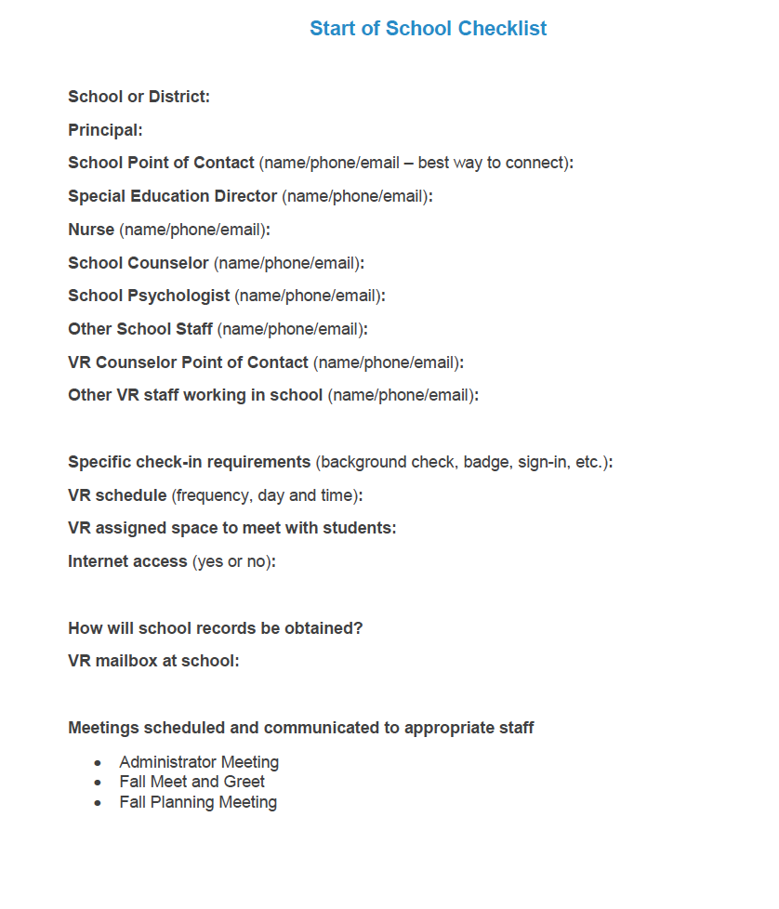

Slide 21
How is your Team (VR/School/Community) Doing with Partnerships?

Slide 22
B. Develop Referral Process
Which students should be referred? Pre-ETS, VR services
When & How should the referral be made?
How will families/parents be involved (permission) & What works best?
Information about Pre-ETS/VR services
Parental consent
What documentation is needed for referral?
Referral form for Pre-ETS or VR, signatures, documentation
Student information, signed by school and family, IEP, SSA, assessments, diagnosis or 504 accommodations
Notes:
When determining a process for referral, education and VR partners need to discuss:
• Which students should be referred to VR?
Students with disabilities verified for special education, student under a 504 Accommodation Plan, and students with a disability for the purposes of section 504 (even if they do not have a 504-accommodation plan in place)
• When should a referral be made?
There is nothing in the statute or regulations that permit the VR agency to deny a VR application based upon a minimum age. The VR agency should take all applications regardless of age and regardless if the student has participated in or is currently receiving pre-employment transition services. 34 C.F.R. § 361.42(c) lists the prohibiting factors in the assessment for determining eligibility and priority of services which include age.
• What are documentation requirements?
For all students with disabilities, including potentially eligible to participate in pre-employment transition services, the following information is needed:
• Unique Identifier e.g., Student ID number
• Social Security Number (if available)
• Date of Birth
• Race-required if student is in secondary education
• Ethnicity – required if students is in secondary education
• Student’s disability
• Start date of pre-employment transition services
• Pre-employment transition services provided
Supporting documentation, relevant to the above-identified required documentation, may include:
– Case note documenting counselor observation, review of school records, statements of education staff; or
• Referral form for pre-employment transition services with the identification of a student’s disability, signed by school staff and parent/guardian if the student is under the age of majority in a State (parental consent to participate in pre-employment transition services is governed by State law, as well as policies of the educational programs and the DSU); or
• Copy of an individualized education program (IEP) document, SSA beneficiary award letter, school psychological assessment, documentation of a diagnosis or disability determination or documentation relating to 504 accommodation(s).
– How will parental consent be secured?

Slide 23
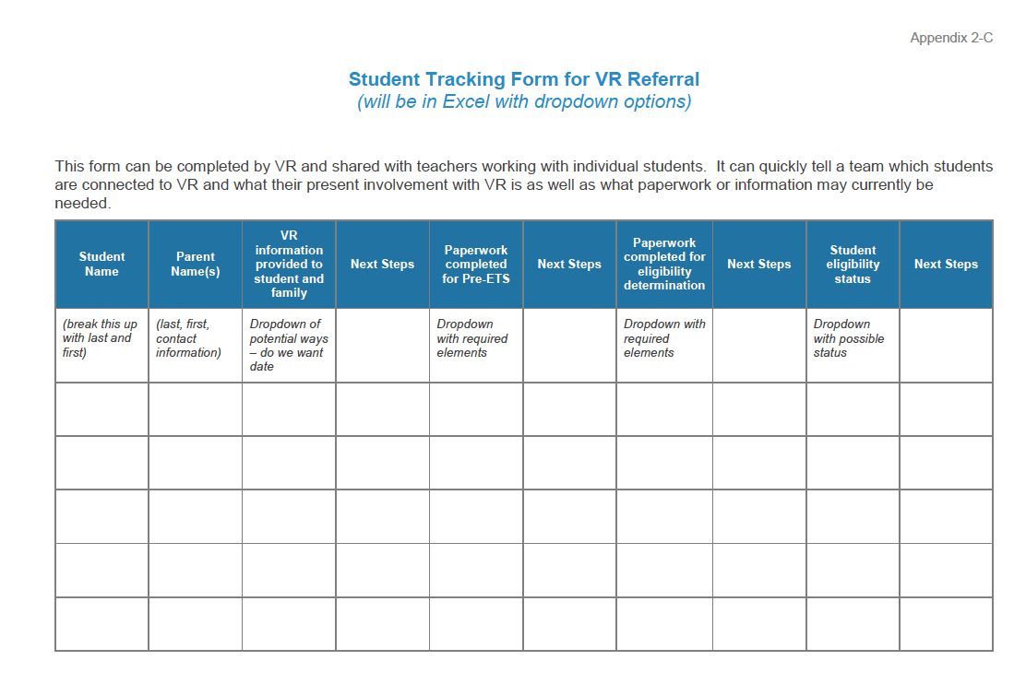

Slide 24
How is your Team (VR/School/Community) Doing with Partnerships?

Slide 25
C. Ongoing Coordination of Transition Services & Pre-ETS: Local Partnership Plan
Planning for day-to-day Operations
Understand range of services available
Design the “Flow of Services”
Define Roles & Responsibilities
Develop new services and supports to fill gaps
Communicate with Families
Share information with youth for individual student planning

Slide 26
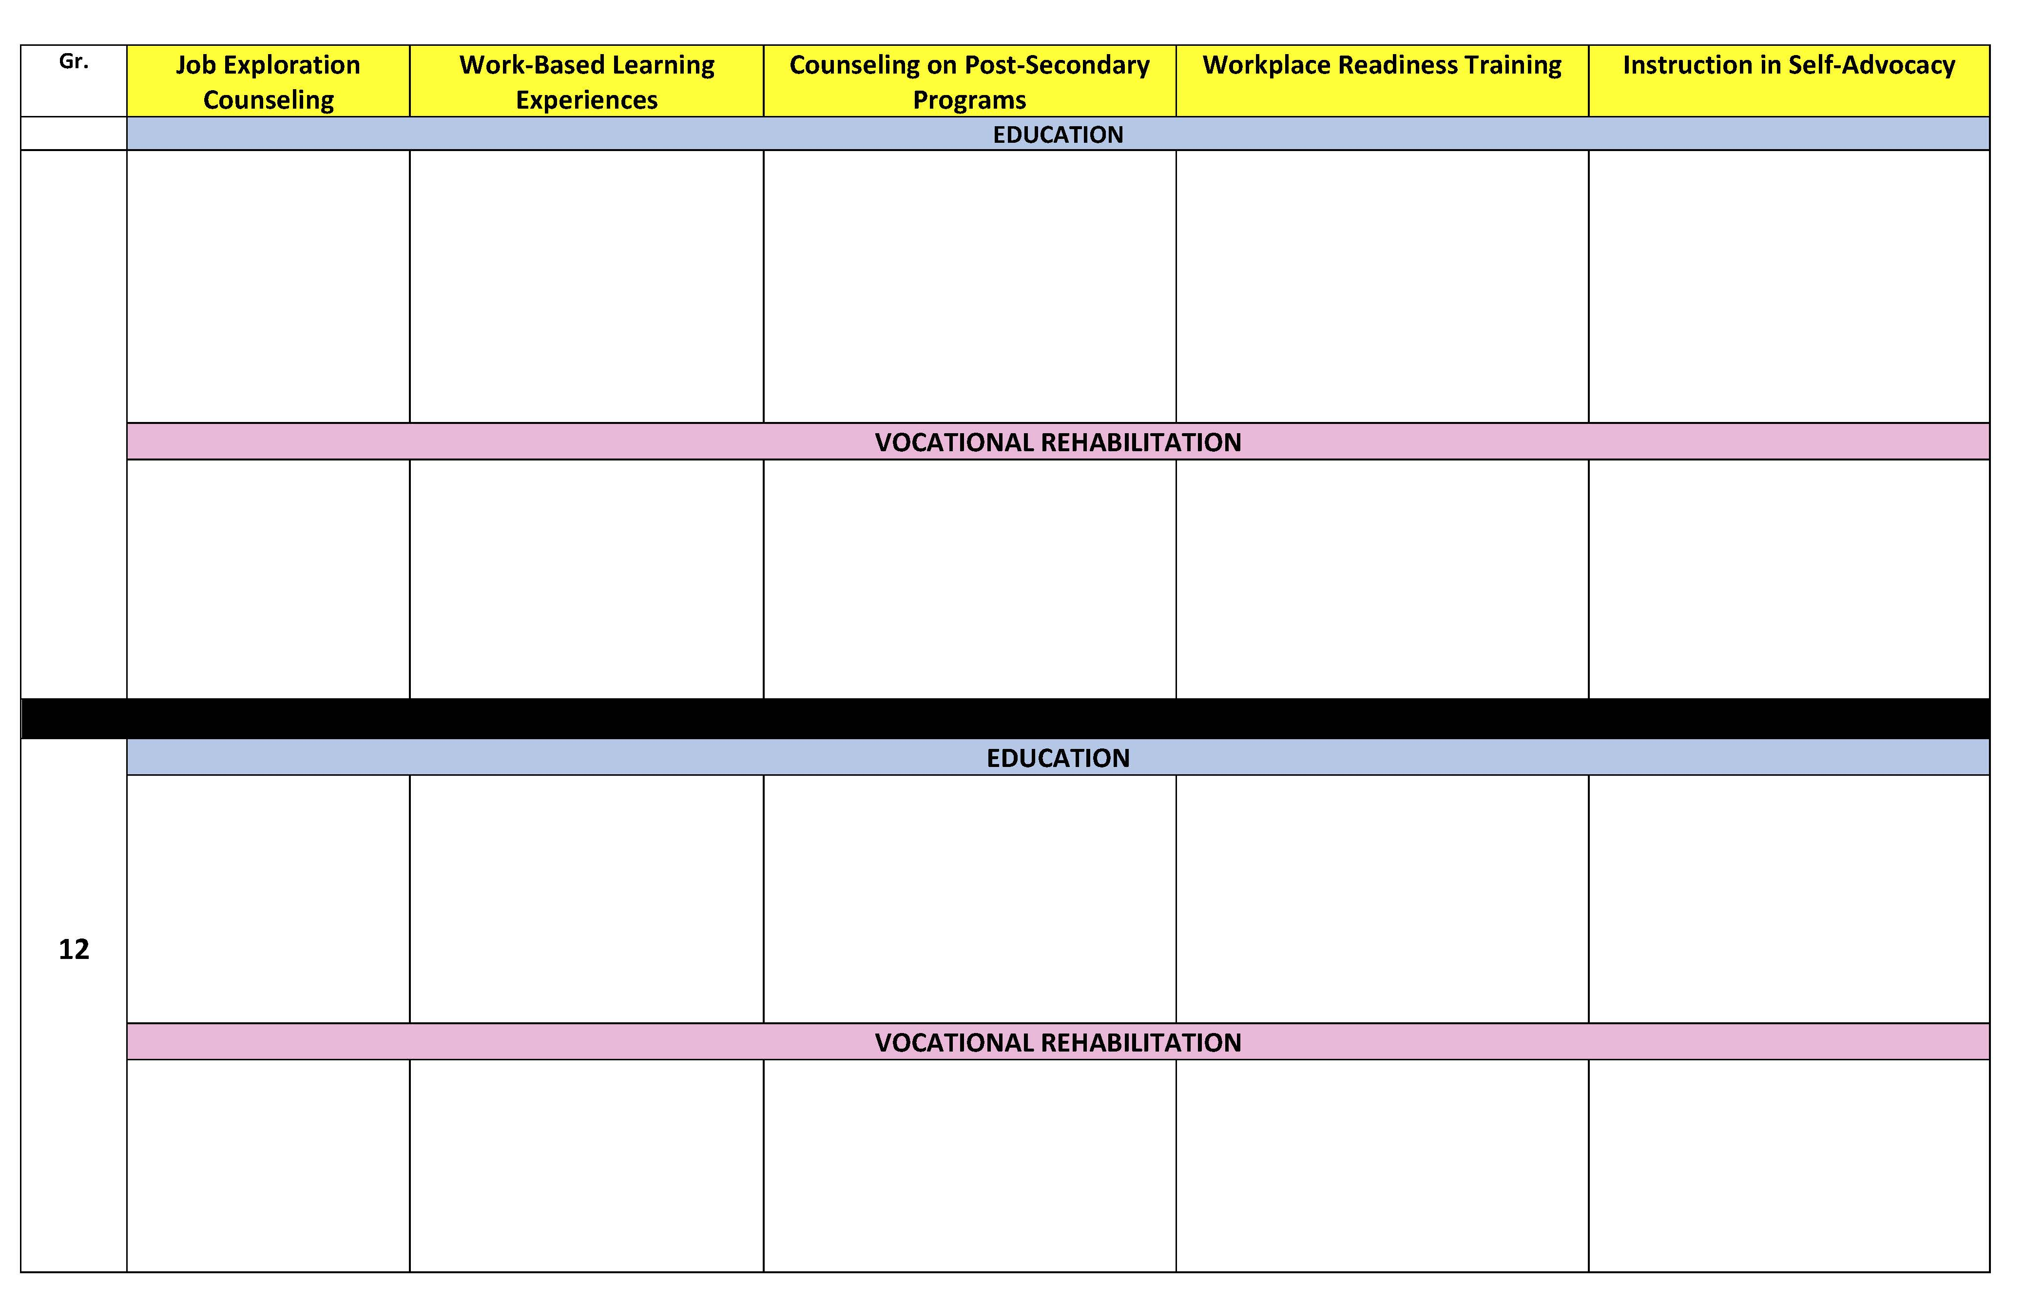
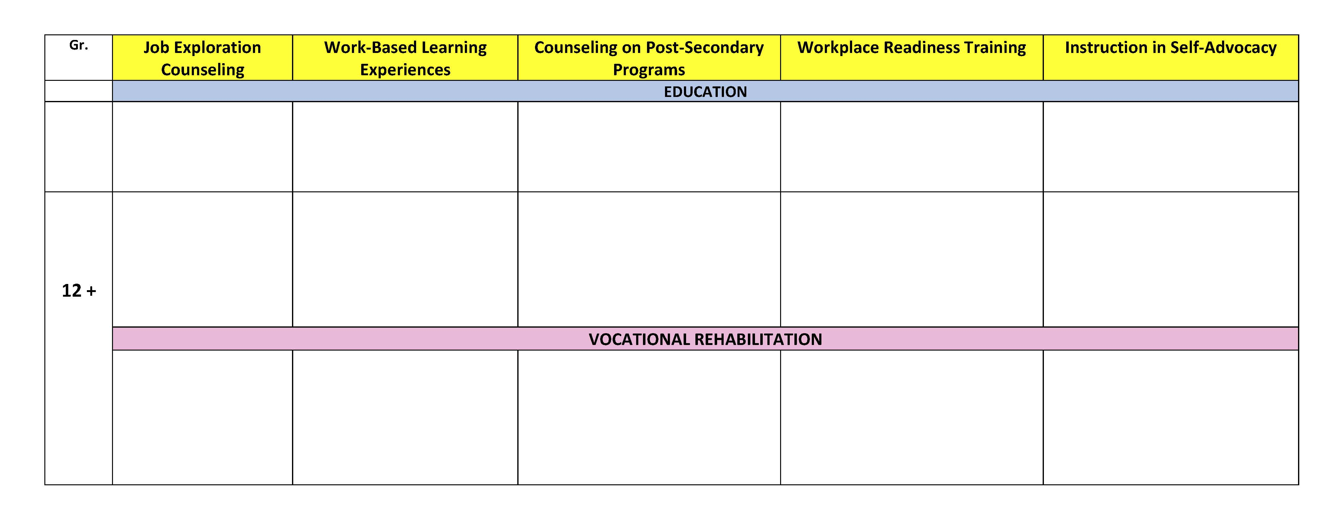
Mapping Sequence of Pre-ETS/VR Services

Slide 28
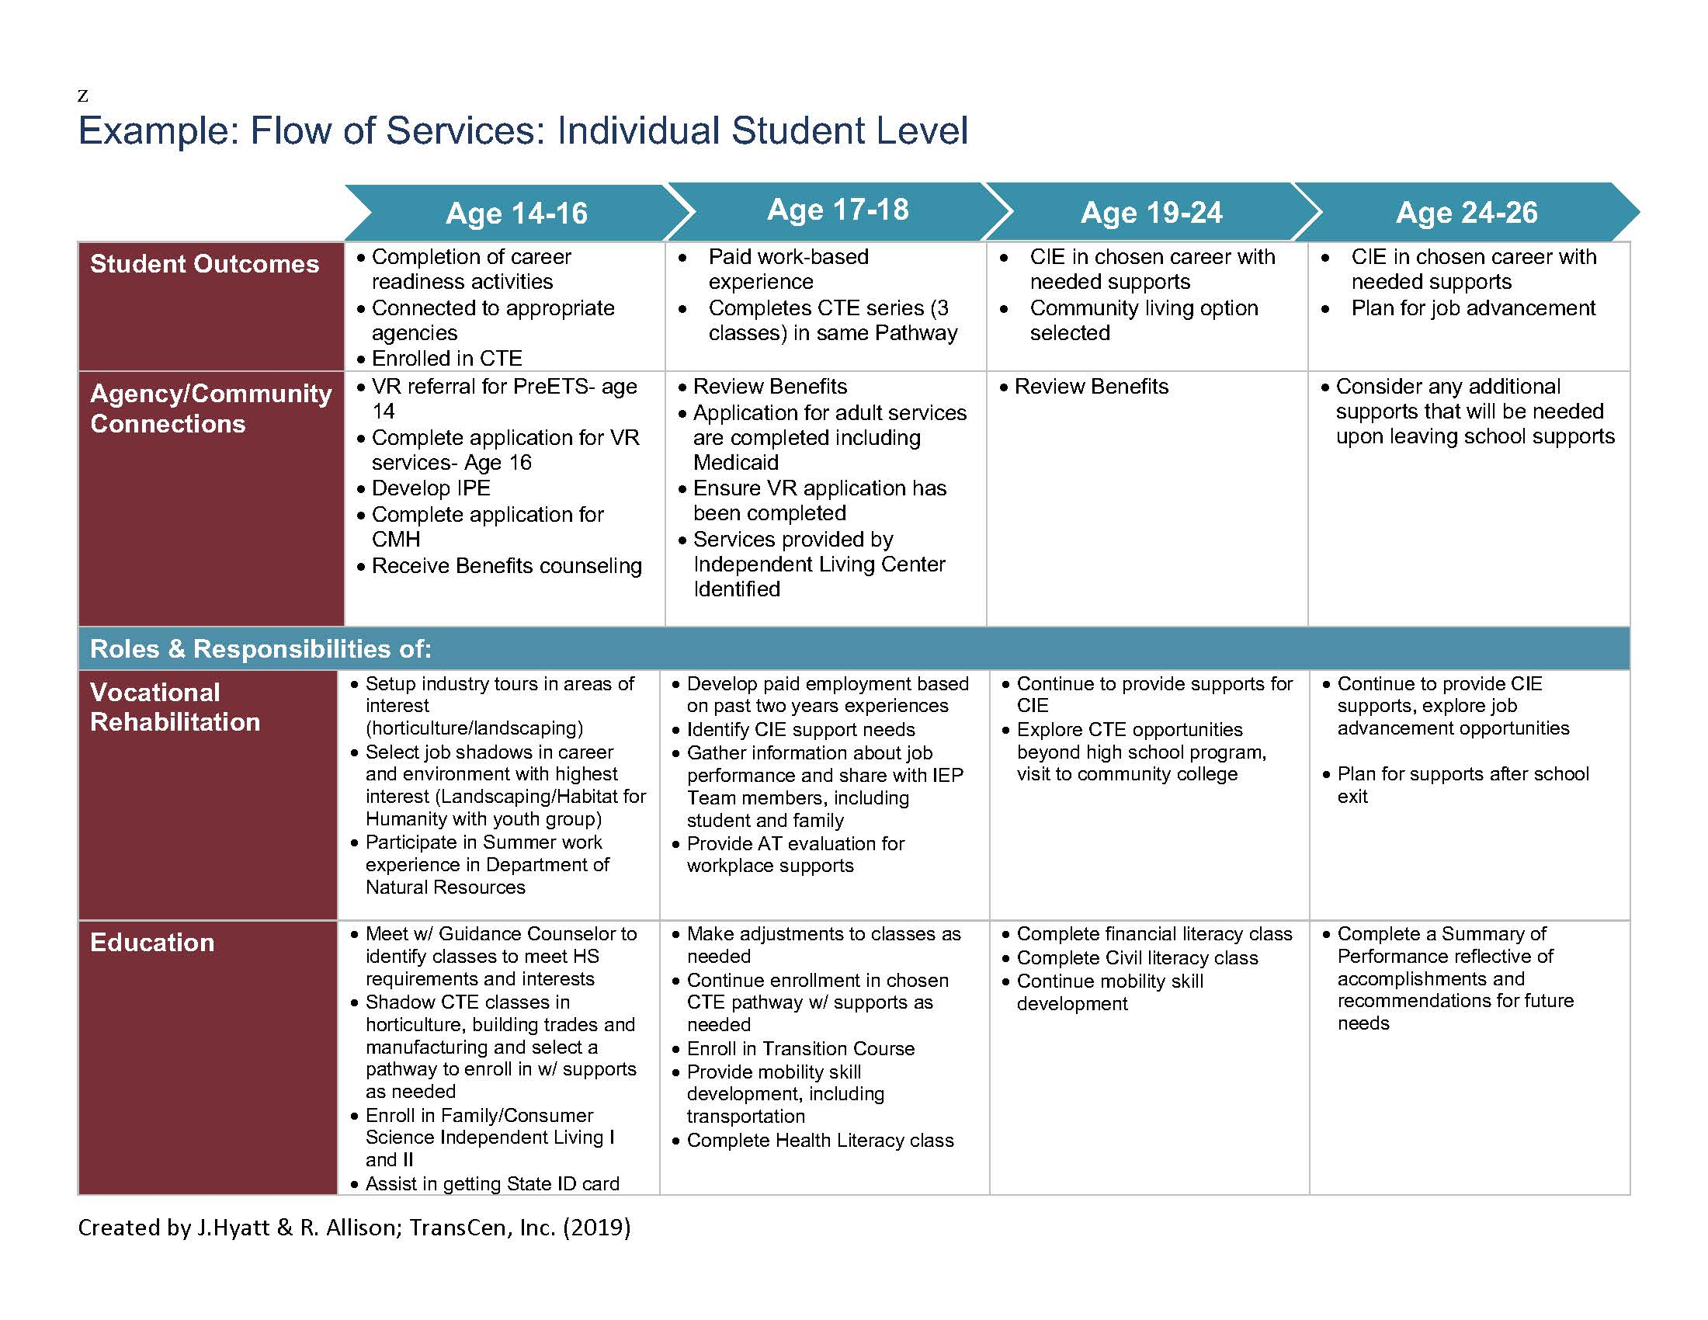

Slide 29
How is your Team (VR/School/Community) Doing with Partnerships?

Slide 30
D. Establish Goals & Evaluate
Create Action Plan using Local Partnership Plan
Schedule Regular Meetings
Identify Goals for the Team Partnership
Identify Data – How you will know you are progressing?
TSAT
Develop Ongoing Approaches to Support Families
Fall Meet and Greet Fall Planning | Winter Check-In | Spring Evaluation & Planning
Notes:
The steps outlined above, and the resources/tools provided throughout the Guide can serve as mechanisms to strengthen your local partnerships as well, as assist a LEA and VR agencies to identify areas of improvement. As you outline areas of improvement, it is recommended to focus on one or two improvement areas or goals each year using a Local Partnership Action Plan. This keeps the work manageable and provides opportunities for the local team to achieve success. Setting timeframes to achieve the goals as well as evaluate progress is recommended. Typically reviewing progress three times a year; at the start of the school year, mid-way through the school year and at the end of the school year, will provide the needed information on progress toward targets. Additionally, it is important to identify what data will be used to measure progress.
Examples to consider:
• Student participation in each of the pre-employment transition services activities
• Student progress in each of the pre-employment transition services activities
• Outcomes of student participation in pre-employment transition services, such as number in paid work and types of jobs
• IDEA Indicator 14
• Numbers of students in each grade and anticipated levels of need
• VR performance indicator data
• Graduation and Drop Out data
• Course enrollment (CTE, general education, transition specific course)

Slide 31
Example: Aligning Work Based Learning
Pre-ETS
(Vocational Rehabilitation)
IDEA Transition Services (Local Education Agency)
Recruit business mentors
Paid or non-paid work experiences
Informational Interviews
Creating internships
Job shadowing
Worksite tours
Leverage VR employer relationships to develop WBL opportunities for students
Out of school WBL activities
Provide job shadowing activities
Provide work experience rotations
Provide school-based work preparation (e.g., mock interviews, resume writing, job applications, school-based enterprises)
Invite guest speakers to present career information
Coordinate with CTE for work based activities
Notes:
Here, we wanted to give you an example of what it might look like to begin to identify and map out some of the work-based learning activities for Pre-ETS that VR can do under the Rehabilitation Act vs some of the related transition services schools can provide to students under IDEA. We also have a handout that we will share with you that was developed by MN VR that provides more detailed examples of activities for each of the five required Pre-ETS services. You might want to look at those examples and customize them for Florida!
For example, VR might facilitate opportunities for students to obtain work experiences within an integrated setting by recruiting business mentors, developing paid work experiences for students, or creating internships; whereas education might set up job shadowing activities or help students prepare for work by helping them complete job applications and mock interviews. These are just a few examples, and as you can tell, many activities do not always fit clearly on one side or the other, and that is really the point of this slide – to emphasize the importance of communication between VR and education in the provision of services to students. For example, what happens if both education and VR are setting up job shadowing experiences for the students…is that okay…maybe…but it will require communication to ensure specific activities are not being duplicated.
State VR Agencies and LEAs have found that developing something like this not only enhances communication in order to reduce duplication and identify service gaps; but also serves as documentation that special education and related services are not being supplanted, by required activities under Pre-ETS. We understand that this type of service mapping or crosswalk activity can be time consuming for States, so you may want to think about how this information can be shared and communicated between VR and the LEA in the most effective and efficient way possible to meet your needs and enhance successful collaboration.

Slide 32
Example of Coordination: IEP with IPE
See video 21:03-22:30
https://mediahub.ku.edu/media/VRSS+WK+3+presentationA+Building+Your+Local+Partnership/0_kwitus3u

Slide 33
A Little Bit of Reflection & Next Steps

Slide 34
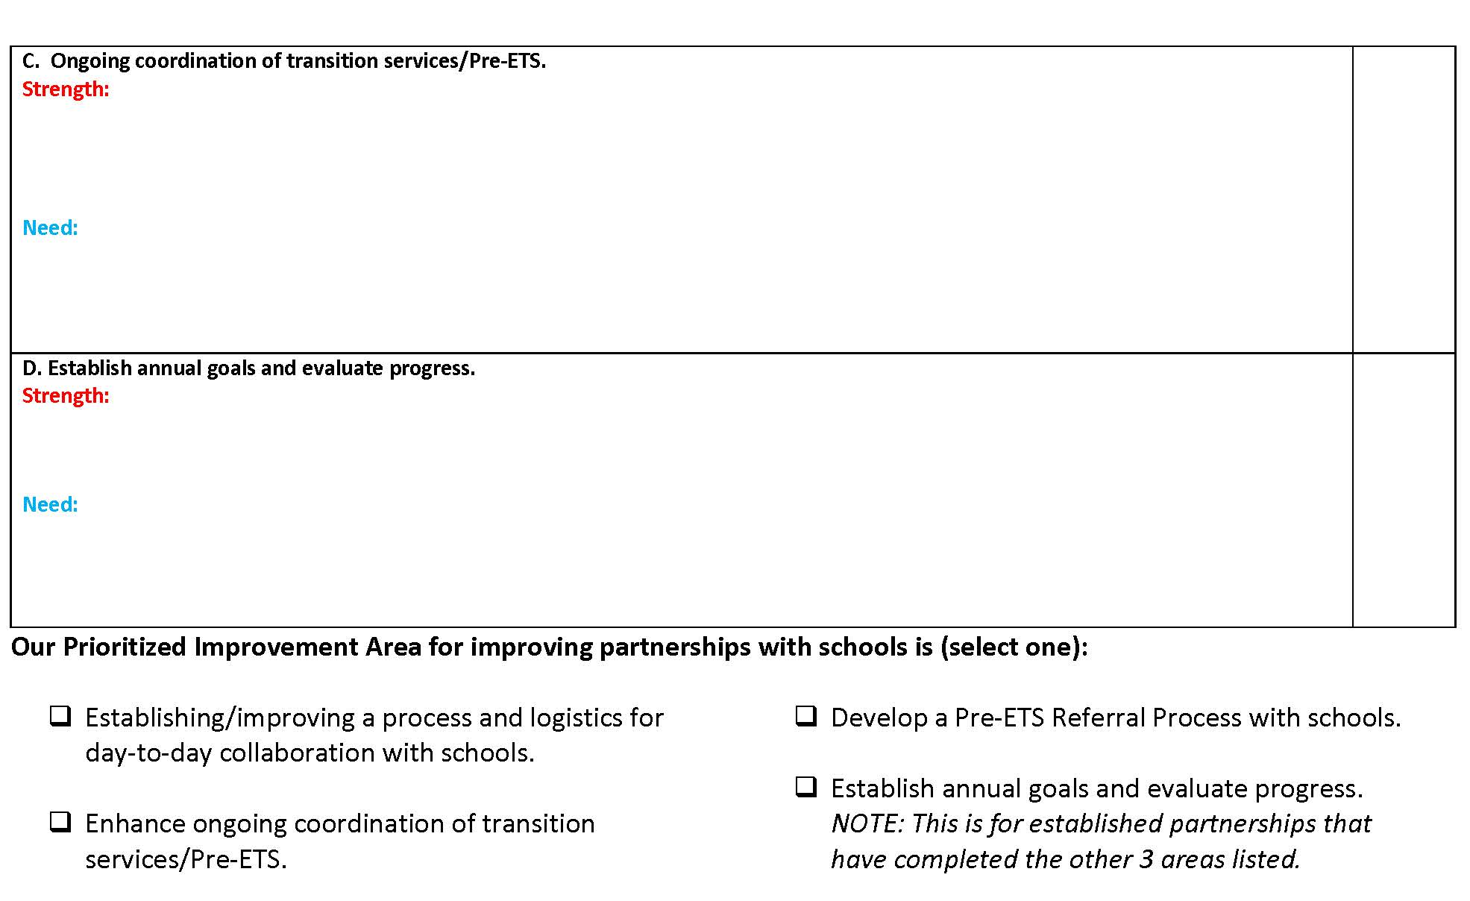

Slide 35
Bonus Resources

Slide 36
Pre-ETS “required” activities
1. Job exploration counseling
T-Folio
https://www.careeronestop.org/ExploreCareers/explore-careers.aspx
https://www.mynextmove.org
Road Trip Nation - YouTube Channel
Dr. Kit Career Videos
Virginia Career View
Notes:
On these next few slides we listed just a few of the on-line tools and resources State VR Agencies, Local Educational Agencies, and schools might want to consider the joint provision of Pre-ETS services for students with disabilities.
For example, T-folio is a free transition portfolio tool for high school age students with disabilities. T-folio has five units that correspond to the five required Pre-ETS activities. Each unit is made up of lessons that contain a lesson guide and at least one activity. Not only does T-Folio have a student introduction or warm up section, but within each unit, they also embed activities that help the student learn more about themselves, and ask the student to reflect on what they have learned, which lays a foundation for them to begin researching occupations.
Career one stop, many of you all have been using that for many many years and it is a great resource where students can explore careers. Although it is not packaged as a formal curricula and it does not include detailed lesson plans, it is a great resource for students, provides a wealth of information on careers and occupations, is easy to navigate, and there are also career videos available in Spanish. Students can do an in-depth exploration of hundreds of occupations simply by entering the name of the occupation they want to search and then they get a brief description of the job, see related job titles, learn more about the job outlook in the future, the average salary, required skills/training, etc. Students can even compare one job to another.
My next move is another really cool resource that you've got to check out. My Next Move is also available in Spanish and it allows students to explore careers in a very fun engaging way, just have the student describe their dream job, or enter the name of the occupation they are interested in, and the student will be taken on an adventure in career exploration. It also includes a career matching feature suggesting careers that match the student’s interests and expected training.
Road trip nation - This quite simply is a fun road trip for students. They can hear from famous actors and distinguished political figures across the nation about how they overcame challenges and found their career path, and hear motivational stories to help them move forward and get excited about their future.
Doctor kit - This resource offers career videos, and the content of the videos focus on four main questions: Describe your typical day - What are the qualifications required for this job? What are the best and worst parts of this job? What final advice do you have for someone interested in this line of work? Dr. Kit also has some unique jobs (logger, farmer, kennel manager, forester) featured in the career videos and has a section of very short video clips that allow for quick interactive career exploration in a short amount of time.
As well as the Virginia career view

Slide 37
Pre-ETS “required” activities
2. Work-based learning experiences
Explore-work.com
NTACT School Based Enterprise Toolkit
Nebraska Virtual Industry Tours
myFuture.com
Notes:
Here are a few more potential tools and resources you may want to consider in the delivery of Work based learning experiences:
Explore Work - is a series of five on-line modules developed by WINTAC, Employment Resources, Inc. (ERI), the University of Wisconsin-Madison, and the University of Wisconsin-Stout Vocational Rehabilitation Institute, that align with the five required activities under the Rehabilitation Act Pre-employment Transition services. Through explore-work, students can create a profile where work can be saved, student progress tracked through certificates of completion and student feedback automatically shared via email with a teacher, VR counselor or other provider. It is available in Spanish. There are three different lessons in the work experience section and they include activities with videos where students can explore different types of work experiences and find the right fit for them.
The NTACT School Based Enterprise Toolkit provides numerous resources and examples for planning, implementing, and succeeding with school-based enterprises that address the development of skills and are planned and run by students.
Nebraska Career Tours is another great resource highlighting hundreds of virtual industry tours within various career pathways. Although the videos showcase different business and industries in each of the sixteen Career Clusters in the Nebraska Model, the virtual industry tours are beneficial for students who reside in any state to view.
Developed by the Department of Defense, myfuture.com™ features career, college and military content, allowing users to explore all possibilities and gain insight into each option. Career resources include information on how to find a job, building a career network, internships, and volunteer work.

Slide 38
Pre-ETS “required” activities
3. Counseling on Opportunities for Enrollment in Comprehensive Transition or Post-Secondary Educational Programs at Institutions of Higher Education
School Beyond High School
NTACT Postsecondary Education and Training Toolkit
Career One-Stop – Find Training at a Glance
Think College
Notes:
Some of the resources for counseling opportunities for enrollment comprehensive transition or postsecondary ed programs
here are a few examples:
One of the other modules in Explore-Work that focuses on the post-secondary education required activity is School Beyond High School – which helps students gain a better understanding of the many options they have for continued learning after high school and what they can do now to prepare for the future. Students can explore what educational or training opportunities are available to help them achieve their employment goals. For example, using the fun and interactive –scavenger hunt education activity guide, students can gather information by connecting with people who have the same type of education and learning that they are interested in who will share their experience and knowledge.
NTACT Postsecondary Education and Training Toolkit- The toolkit explains the array of post-secondary education and training options for young adults with disabilities after they complete high school. This toolkit is intended as a resource for any student with a disability, family member, service provider, or educator of a student with a disability, to consider options and plan for post-secondary education and training access and success.
The Career One-Stop site that I mentioned on the last slide also includes a great section on “Find Training”, where students can quickly explore colleges and learn more about colleges that might meet their individual needs through the Local Training Finder, where they can search for schools by keyword and location.
Think College – We also wanted to mention that Think College, which is operated out of the Institute for Community Inclusion at the University of Massachusetts Boston creates and curates over 600 selected resources on a wide range of topics related to postsecondary education for people with intellectual disabilities. Think College also includes some of the most frequently asked questions that families have about college options.

Slide 39
Pre-ETS “required” activities
4. Workplace readiness training
Skills to Pay the Bills
Realityworks Curriculum
Dr. Kit - Essential Skills
Notes:
A few Workplace readiness training resource examples include:
The Office of Disability Employment Policy (ODEP) developed a curriculum focused on work readiness and interpersonal (soft) skills called Skills to Pay the Bills. Soft Skills curriculum is a marvelous teaching tool that is able to reach ALL students wherever they may be in their learning process." The curriculum can be downloaded as one large document or individually by soft skill topic. Seven short (2-3 minute) videos are available: a synopsis of the curriculum and one video for each of the skill categories. The curriculum is also available in Spanish. Soft skills are grouped into six categories with multiple lesson activities that are creative, hands-on and reflect universal design for learning principles. The six soft skill categories include the following: Communication, Enthusiasm and Attitude, Teamwork, Networking, Problem-Solving and Critical Thinking, and Professionalism.
Realityworks provides comprehensive learning solutions that pair curriculum with hands-on learning aids, student activities and assessment tools to create innovative learning environments. Some products are available for purchase; however there are also some free lesson plans available to download once you complete the registration form. These free employability skills lessons were created to help teach students the important soft skills needed to prepare for a career. Each lesson begins with an overview, lesson objectives, and a Lesson-at-a-Glance table, which lists the lesson activities, materials required, suggested preparation steps, and approximate class time. The overview is followed by the actual lesson. Most lessons are designed to be completed within 45 minutes. Every lesson begins with a FOCUS activity intended to capture students’ attention. This may be in the form of a small or large class discussion, game, review of previous lesson information, or demonstration. During this activity, students are introduced to the topic of the lesson. The majority of lessons end with a SUMMARIZE activity intended to briefly review the lesson’s key messages or main points.
Dr. Kit also has a section on Essential Skills - often called “soft skills,”. They have short videos meant to get students thinking about their own behavior, and how they can improve in each of these areas. Dr. Kit includes 8 different lessons in this section: Goal-Setting, Attitude, Written Communication, Communication (Speaking/Body Language), Behaving Ethically, Motivational Skills,Teamwork, and Time Management

Slide 40
Pre-ETS “required” activities
5. Instruction in self-advocacy
University of Oklahoma - Zarrow Center
The 411 on Disability Disclosure
Project 10 - Student Engagement & Success
Indiana Secondary Transition Resource Center - Self Determination
Notes:
And then finally instruction in self advocacy, just a few resources you can go to include:
The University of Oklahoma, Zarrow Center has a lot of great information on self-determination and self-advocacy. I wanted to highlight one resource in particular: The ChoiceMaker Self-Determination Curriculum. It is Designed to Teach Students the Self-Determination Skills Needed to be Successful in Adult Life; and it consists of three strands: (1) Choosing Goals, (2) Expressing Goals, and (3) Taking Action. Each strand addresses teaching objectives in three transition areas: Education, Employment, and Personal.
The 411 on Disability Disclosure is designed for students and adults working with them to learn about disability disclosure and help them make informed decisions about whether or not to disclose their disability and understand by considering how that decision may impact their education, employment, and social lives.
Project 10 – Student Engagement and Success - This site provides materials and resources for school professionals, families and students with disabilities regarding student engagement for secondary transition success.
The Indiana Secondary Transition Resource Center ‘s website provides information regarding a variety of publications, links to helpful organizations, fact sheets, and checklists pertaining to self-determination and self-advocacy skill development.

Slide 41
IDEA Transition Related Activities
Transition Assessments – Student and parent transition surveys many on-line assessments of self- determination, career interests and strengths, etc.
Transition Assessment Matrix
www.transitioncoalition.org
Personal Preference Indicators: A Guide for Planning
Life Course Framework
I’m Determined.org
Life skills – Household chores (cleaning room, dishes, laundry, taking out garbage, setting table, inventorying household supplies); meal planning (grocery list, shopping, cooking); money skills; outside/yard maintenance; importance of good hygiene.
Social Skills - practice using various media to keep in contact with family and friends – phone calls, text, FaceTime, social media (safely), Zoom, etc.
Notes:
It is important that State VR Agencies and LEAs develop something like a crosswalk or a way to map out IDEA transition related services vs the Rehab Act-WIOA pre-employment transition services that the student will be receiving, to help not only reduce duplication and fill in service gaps; but also document that special education and related services are not being supplanted, but rather enhanced or supplemented by required activities under Pre-ETS. We understand that this type of service mapping or crosswalk activity can be time consuming for States, so you may want to think about how this information can be shared and communicated between VR and the LEA in the most effective and efficient way possible to meet your needs and enhance successful collaboration.
We have talked about the Rehab Act Pre-ETS services, now this slide provides an overview of IDEA Transition Related Activities. We have listed them into three key areas: Transition Assessments, Life Skills, and Social Skills.
Transition Assessments – Student and parent transition surveys many on-line assessments of self- determination, career interests and strengths, etc.
Transition Assessment Matrix
www.transitioncoalition.org
Personal Preference Indicators: A Guide for Planning
Life Course Framework
I’m Determined.org
Life skills – Household chores (cleaning room, dishes, laundry, taking out garbage, setting table, inventorying household supplies); meal planning (grocery list, shopping, cooking); money skills; outside/yard maintenance; importance of good hygiene.
Social Skills - practice using various media to keep in contact with family and friends – phone calls, text, FaceTime, social media (safely), Zoom, etc.

Slide 42
More Resources
Interagency Agreement Toolkit
Pre-Employment Transition Services: A Guide for Collaboration Among State Vocational Rehabilitation Agencies and Education Partners
Community Rehabilitation Providers Pre-ETS Guidebook
A Teachers Guide to Collaborating with Vocational Rehabilitation
Resource Mapping Toolkit

Slide 43
Resources
Side by Side: https://transitionta.org/sidebyside/
Pre-ETS mini-module on TC site: https://transitioncoalition.org/module-1/pre-ets-page-4/
Pre-ETS on the NTACT:C: https://transitionta.org/topics/pre-ets/
Interagency Collaboration on NTACT:C: https://transitionta.org/interagency-collaboration/
Interagency Collaboration Module on TC: https://transitioncoalition.org/blog/id-intro-page/
VR Transition Services on NTACTC:C: https://transitionta.org/topics/vr-transition-services/

Slide 44
Find us on:   #transitionTA | transitionTA.org | ntact-collab@uncc.edu
The contents of this presentation were developed under a grant (H326E200003) from the Department of Education. However, those contents do not necessarily represent the policy of the Department of Education, and you should not assume endorsement by the Federal Government.
44

