Slide 1
To the Moon and Back: Working Together to Improve Outcomes
Mary E Morningstar, PhD
WTP 2023
mem28@pdx.edu

Slide 2
NTACT:C
https://transitionta.org/
Create an Account NOW!!

Slide 3
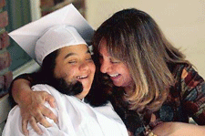
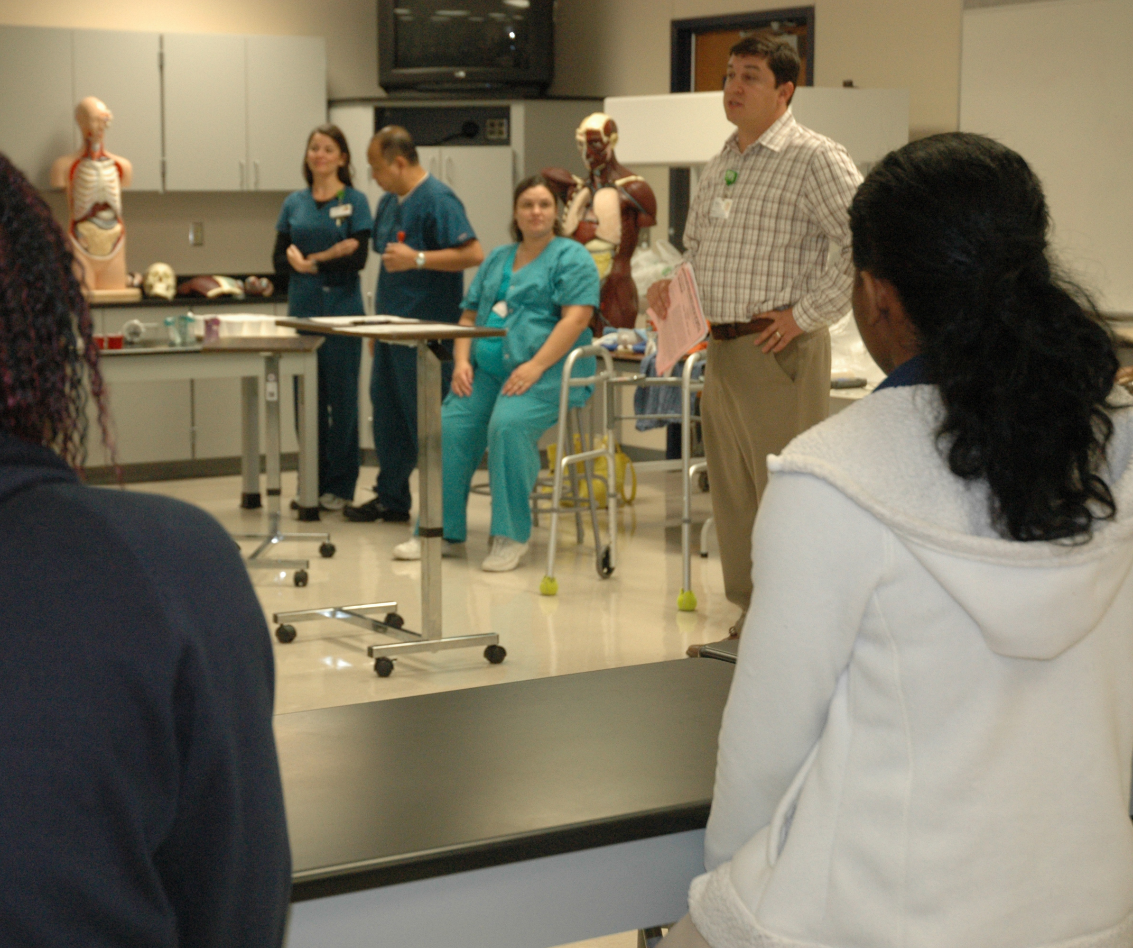
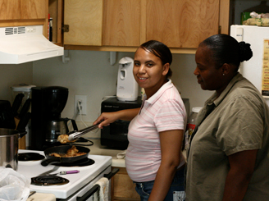
What does “transition” mean to you?
Notes:
Look at each of the pics and make sure they are covered

Slide 4
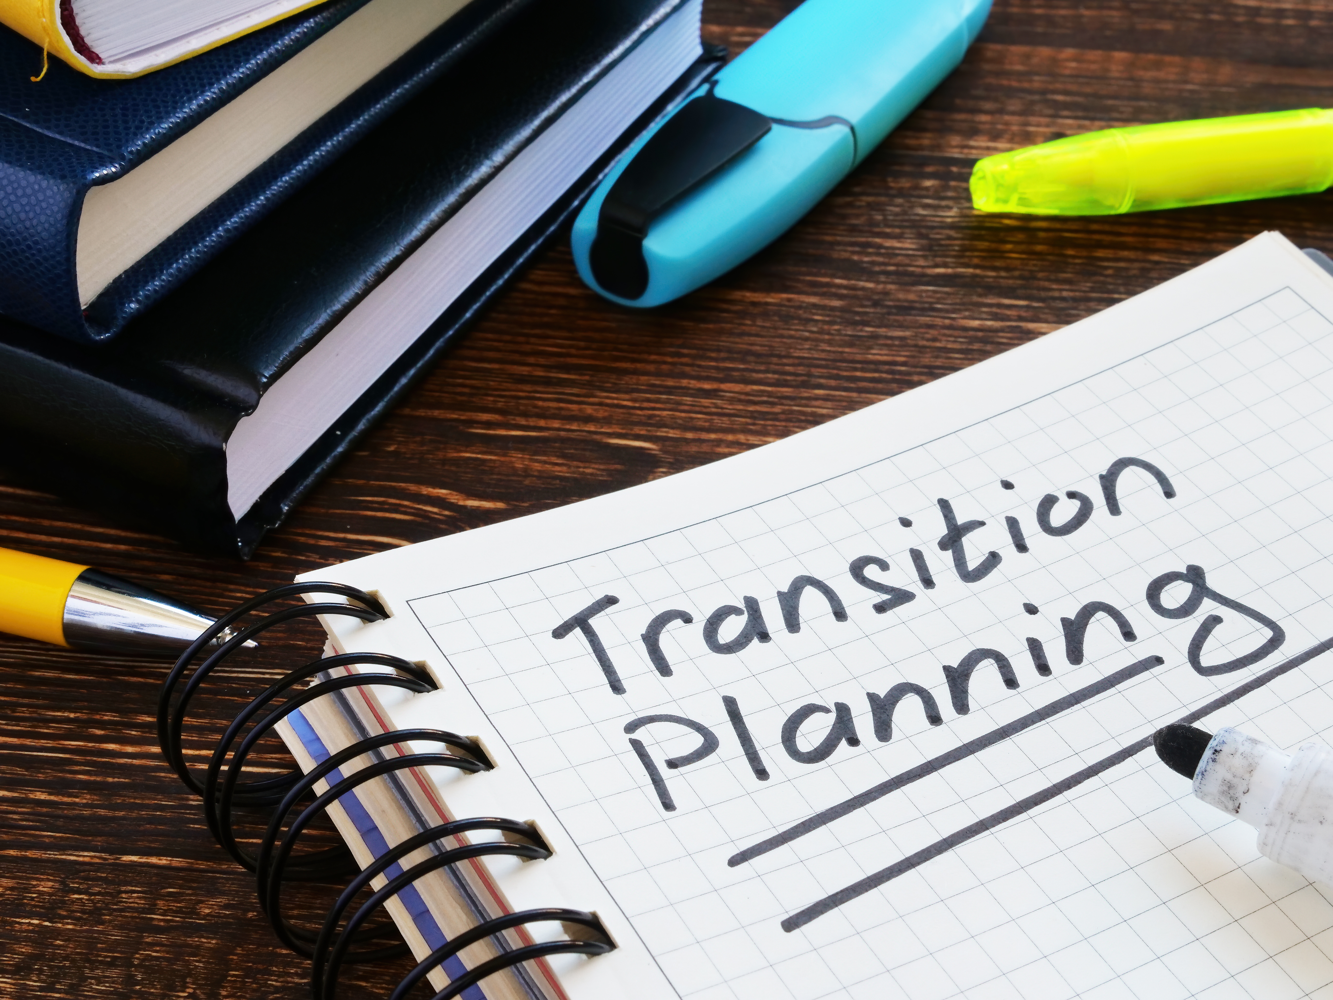
Transition Planning is….
“a period of floundering that occurs for at least the first several years after leaving school as adolescents attempt to assume a variety of adult roles in their communities” (Halpern, 1992)
Transition is the process of movement through life phases, as students move from the structure of one social institution or delivery system to that of another (OSERS, 1984)
Notes:
First one seems real
Second is legalistic

Slide 5
IDEA 2004
The Individuals with Disabilities Education Act (IDEA) was enacted by the federal government to ensure that all children with disabilities are provided with “equality of educational opportunity, full participation, independent living, and economic self-sufficiency.”

Slide 6
Where are we Today? Begin with the End In Mind
High quality transition services
Challenge to meet the demands of adulthood
Inspire through opportunities to realize dreams for future
Collective action & collaboration, draw on that power
Notes:
High quality transition services – learn about it early and provide the array of sped interventions – access to general education, related services, experiences, communication, etc. and intensify transition services over time
Challenge students, families, practitioners to ensure they can meet the demands of adulthood
Inspire students, families and practitioners with opportunities to realize dreams for future
Collective action and collaboration, draw on that power

Slide 7
So what’s the big deal?
Notes:
Transforms how we provide services and supports

Slide 8
EXPECT: High Expectations Lead to…
Families | Academics, integrated competitive employment, postsecondary education, community living
Teachers | Student academic achievement
Students | Postsecondary education, employment, financial self-sufficency
Practitioners | Seamless delivery of transition services leading to higher paying jobs that match career interests and abilities
Notes:
Families learn from the models shared with them by teachers
Over the student’s academic career, beginning in early childhood, we need to hold high expectations
Families with high expectations achieve greater academic, employment, independent living success
Students recognize teachers who hold high expectations and they perform better academically
Better PSE, employ, financial self-sufficiency
Achieve potential and lead fulfilling adult lives
Seamless delivery relies on collaboration of ed/VR and adult services that authentically engage youth lead to higher paying jobs and that match their abilities and interests

Slide 9
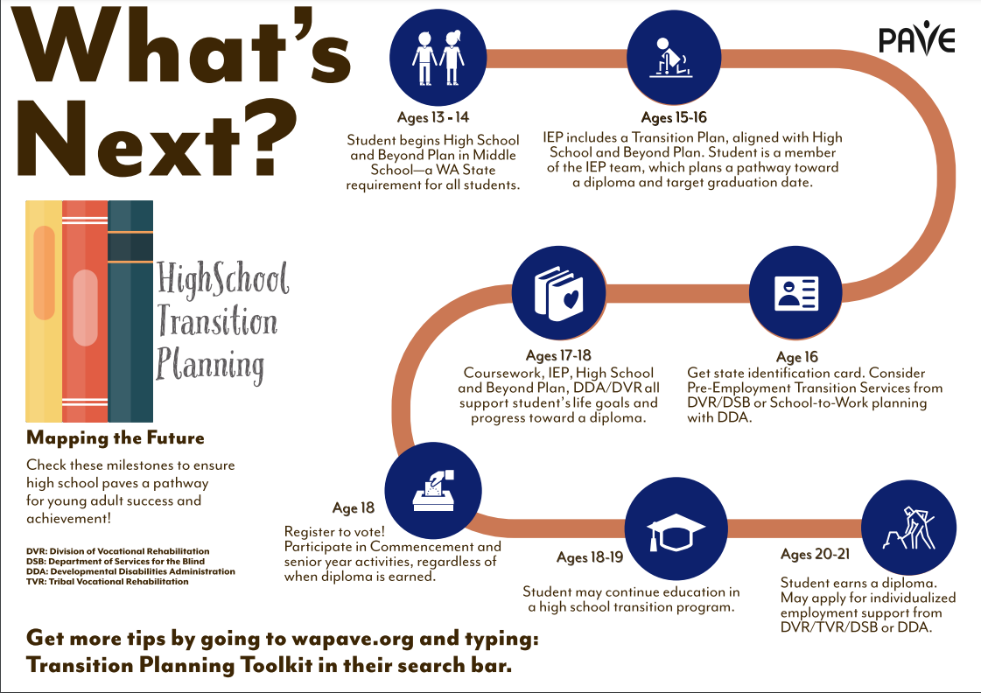
Transition Timeline
https://wapave.org/whats-next-high-school-transition-planning-timeline/

Slide 10
ENGAGE: How it is Operationalized
Early Planning with Families & Individuals
Inclusive, Rigorous & Relevant Educational Experiences
Supports & Services Tied to Outcomes
Practitioners Knowledgeable of EBPPS
Notes:
Begin planning early to engage families and youth to access transition services when needed
Ensure they have rigorous education with appropriate conditions for learning to ensure successful pathways to life beyond HS
Every aspect of specialized instruction, related services, curricular standards, access to inclusive gen ed leads and connects to building the purpose of preparing youth for adulthood
Families acquire the knowledge and skills needed to engage – in environments responsive to their assets (cultural wealth)
Practitioners provide support and services needed eg.., WBL, Pre-ETS

Slide 11
EMPOWER
Self-Advocacy
Youth Leadership
Re-engaging Youth
Supported Decision-making
Family supports
Community Partnerships
Collaboration
Notes:
Empower youth and families to access services when needed
requires collaboration among all practitioners with youth and families engaging

Slide 12
Why are Partnerships Important?
Notes:
only 21.5% percent of youth with disabilities nationally are enrolled in higher education within one year of leaving high school—and this figure has consistently been decreasing over the past five years (a 20% reduction).
For all youthNational Center for Education Statistics, reporedt that 63% of all high school students who graduated in the 2019-2020 were enrolled in post-secondary education by October 2020.
This gap and the gap of adults with disabilities who are in the United States labor workforce compared to their nondisabled coworkers need to be addressed.
What are the benefits?

Slide 13
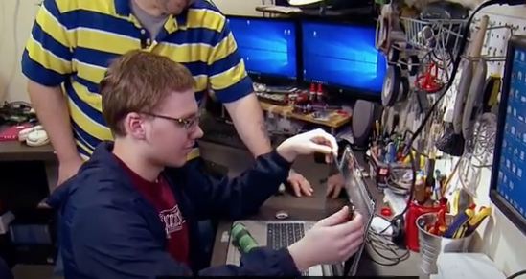
Partnerships
Building Relationships & Developing Trust
When two parties come together for the common good of a school or to enhance student learning.
Partners can include anyone who is interested in or committed to enriching educational experiences for students, families, schools, and the community.
Notes:
https://youtu.be/ZlOZcUdNB0Y
Build Relationships 1:08-1:28
Develop Trust 3:15-3:56

Slide 14
Employment
How do we get there?
1
Work-Based Learning
2
Pre-ETS & Transition Services
3
Inclusive “real internships”
Career Development & Counseling
4

Slide 15
Postsecondary Education
How do we get there?
1
MS/HS – Access to Gen Ed; programs like AVID
2
Self-Advocacy
3
Accommodations & Assistive Technology
Think College
4

Slide 16
Community Engagement & Living
How do we get there
1
Inclusion in and out of school
2
Flexibility in services
3
Adult Roles & Responsibilities
Self-Advocacy, Supported Decision Making
4

Slide 17
Wrap Up
The end game should always be about ___________ (who?)
Working together will reduce duplication and fill in the gaps ________ (who?) will be better prepared!
How can YOU Be a Valued Partner
Communicate
Build trust
Be consistent
Individualize supports
Share Information
Ask Questions
Share Power with _________ (who?)
Notes:
90% of DVR staff indicated they had a very good relationship with their schools – that is great because without that relationship it will be very hard to do all of the things we talked about today to ensure services are being supplemented and not supplanted.

Slide 18
#transitionTA | transitionTA.org | ntact-collab@uncc.edu
The contents of this presentation were developed under a grant (H326E200003) from the Department of Education. However, those contents do not necessarily represent the policy of the Department of Education, and you should not assume endorsement by the Federal Government.

