Slide 1
Leveraging Rural Strengths and Developing Community Partnerships: Strategies for Supporting Effective Coordinated Transition Services
Josh Taylor, PhD
Holly Whittenburg, PhD

Slide 2
Session Overview
Barriers faced by transition-aged students with disabilities in rural communities
Assets specific to rural communities
Strategies and Solutions
Discussion

Slide 3
Barriers
Transportation
Limited Work Experiences
Less Services/Supports
Isolation
People's Perceptions
Notes:
USDA - open countryside, rural towns (places with fewer than 2,500 people), and. urban areas with populations ranging from 2,500 to 49,999 that are not part of larger labor market areas.

Slide 4
Why do families and students choose to live and work in rural parts of the Northwest?

Slide 5
Rural Asset: The Rural Mindset
Asset-based approach
Collaborative, hands-on, problem-solving
Deep connections to their natural surroundings
The original tinkerers, reduce/reuse/recyclers, fixers and networkers

Slide 6
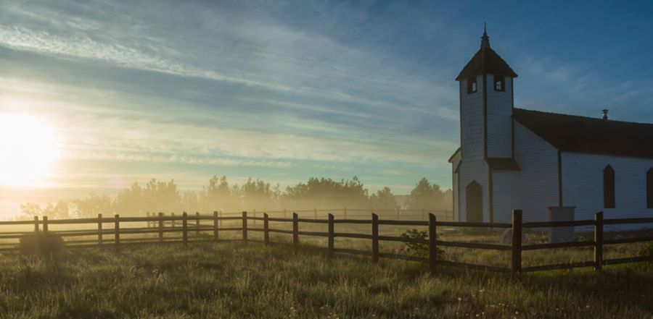
Social Capital
What is social capital?
What does it mean to belong to a rural community?
Importance of social networks within rural communities

Slide 7
Let's Try It!
Who would you go to when you need advice?
Who would you go to when you want to have fun?
Who would you go to learn more about ________?
Who would you go to when you have a problem?
Notes:
First answer for themselves, then for a student.

Slide 8
Rural Asset: Small Businesses
https://advocacy.sba.gov/wp-content/uploads/2022/08/Small-Business-Economic-Profile-WA.pdf
Notes:
https://advocacy.sba.gov/wp-content/uploads/2022/08/Small-Business-Economic-Profile-WA.pdf

Slide 9
Rural Asset: Local, Small, Flexible
Locally/family-owned businesses
Greater flexibility
Local decision-making powers
Less overarching corporate policies/procedures
Nation’s major drivers of job growth
High demand for employees
Greater flexibility in required amount of hours, schedule, and conformity
More willing to hire previously overlooked candidates

Slide 10
Rural Asset: Unique Industries
Notes:
ADD IN EXAMPLES OF WASHINGTON INDUSTRIES

Slide 11
How can we leverage assets of rural communities to improve transition services for students with disabilities?

Slide 12
Student-Centered Planning
Student preferences, interests, needs, and strengths (PINS)
Collaborative planning
Career development
Match between student goals, different plans, and services and training

Slide 13
Developing Community Partnerships
Connecting
Connecting with other agencies/organizations
Building
Building relationships with employers
Fostering
Fostering connections between students and families and their communities

Slide 14
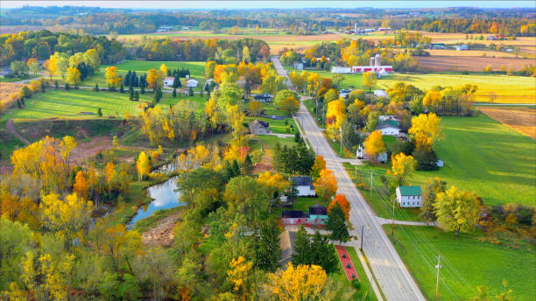
Community Resource Mapping
What is it?
How to do it
Benefits

Slide 15
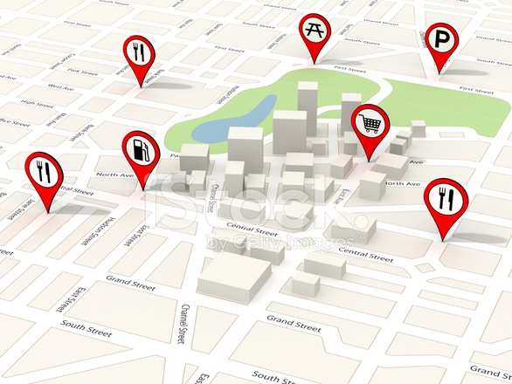
Let's Try It!
Community resource mapping

Slide 16
Connecting Students with Businesses
Worksite Tours
Informational Interviews
Job Shadowing
Work-Based Learning

Slide 17
Connecting Students with Businesses
Worksite Tours
Low stakes opportunity to explore
Provides opportunities for students to observe workplace models
Consider barriers to accessibility

Slide 18
Connecting Students with Businesses
Informational Interviews
Students have pre-written questions to ask employers
Learn about business, employment expectations, needed skills

Slide 19
Connecting Students with Businesses
Job Shadowing
Students observe for an extended period of time
Begin to learn daily operations
Develop connections with employees

Slide 20
Connecting Students with Businesses
Work-Based Learning
Internships/work experiences
Designed for learning job skills
Utilize natural supports
Learn how to maintain schedule and fulfill job duties

Slide 21
Changing the Narrative
Demonstrating the potential of students with disabilities
Work portfolios
Video resumes
Job trials/working interviews
Disability awareness training
Success stories

Slide 22
Self-Employment
What is it?
How can it be helpful?
Process for becoming self-employed
What might student entrepreneurs with disabilities need to be successfully self-employed?

Slide 23
Washington Entrepreneurship Resources
https://wsbdc.org/
https://www.commerce.wa.gov/growing-the-economy/business-services/
https://www.cie-nw.org/
https://www.arc-Spokane.org/boss
https://www.dshs.wa.gov/sites/default/files/dvr/DSHS%20DVR%20Program%20Opportunities.pdf

Slide 24
Technology
How can technology support rural work experiences?
Remote work
Tele-services

Slide 25
Let's Brainstorm!
How could we address barriers related to
Transportation
Limited Work Experiences
Less Available Supports/Services
Isolation
People's Perceptions

Slide 26
Considerations for Rural Transition
Networking
Grow your own
Consider family connections and nontraditional community sites
Seek out non-traditional partners and approaches to service provision
Consider funds, grants, remote options, and natural supports
Think outside the coffee cart!
Transportation
School-based options

Slide 27
Questions and Comments?
THANK YOU!
Holly Whittenburg –holly.whittenburg@wsu.edu
Josh Taylor – josh.taylor@wsu.edu

